Slide 1
LM Efficiency
CSCI 601-771 (NLP: Self-Supervised Models)
https://self-supervised.cs.jhu.edu/fa2025/

Slide 2
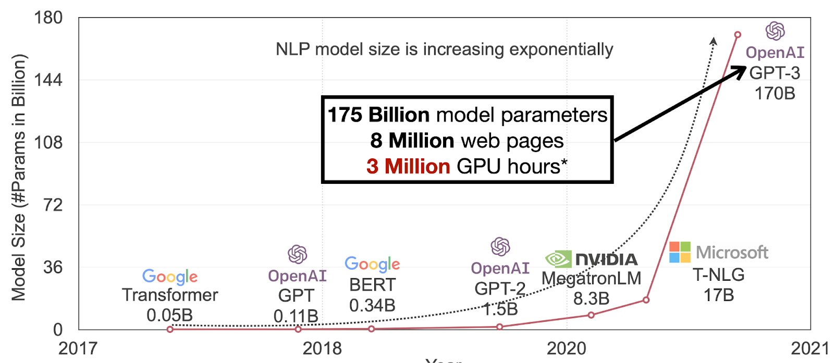
Our models are getting larger!
TBD
Figure Credit: Song Han (MIT)

Slide 3
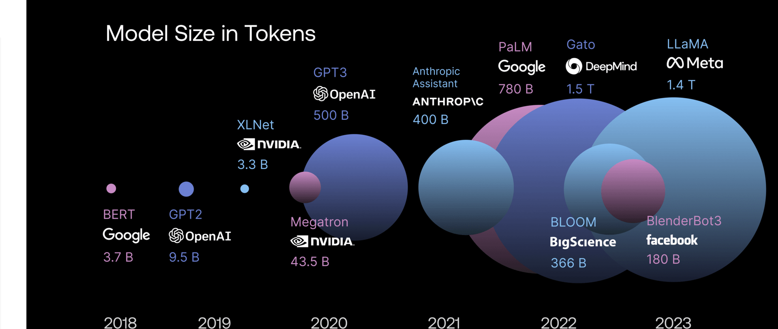
And consumes a lot of data!

Slide 4
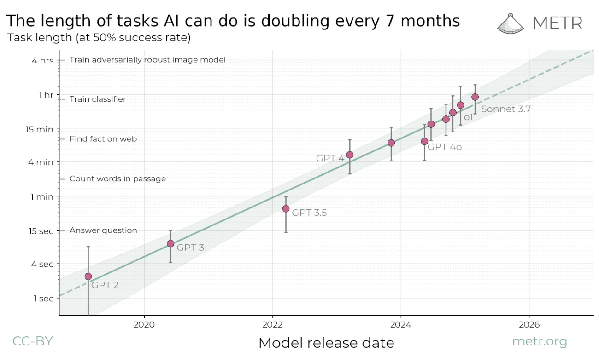
Reasoning models solving long tasks

Slide 5
Compute cost of Transformers

Slide 6
Diversion: Floating-point Ops: FLOPS
Floating point operations per second (FLOPS, flops or flop/s)
Each FLOP can represent an addition, subtraction, multiplication, or division of floating-point numbers,
The total FLOP of a model (e.g., Transformer) provides a basic approximation of computational costs associated with that model.

Slide 7
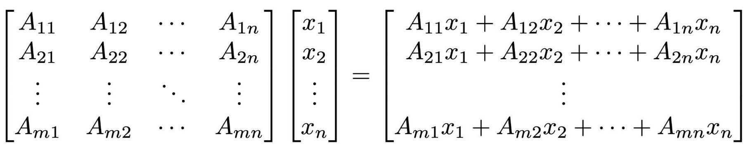
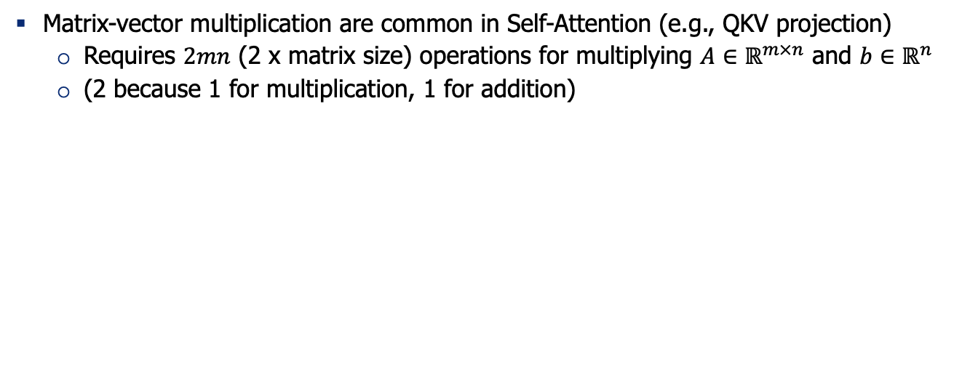
FLOPS of Matrix Multiplication
Matrix-vector multiplication are common in Self-Attention (e.g., QKV projection)
Requires $2mn$ (2 x matrix size) operations for multiplying $A∈ℝ^{m×n}$ and $b∈ℝ^{n}$
(2 because 1 for multiplication, 1 for addition)

Slide 8
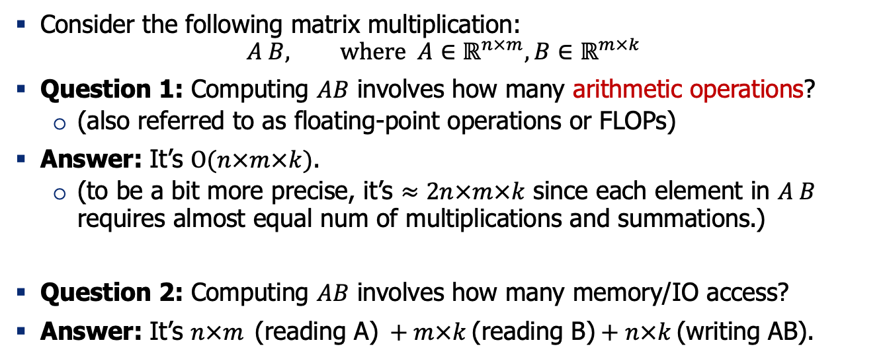
Quiz: thinking about computations
Consider the following matrix multiplication:
$$A B, where A∈ℝ^{n×m},B∈ℝ^{m×k}$$
Question 1: Computing $AB$ involves how many arithmetic operations?
(also referred to as floating-point operations or FLOPs)
Answer: It’s $O(n×m×k)$.
(to be a bit more precise, it’s $≈2n×m×k$ since each element in $A B$ requires almost equal num of multiplications and summations.)
Question 2: Computing $AB$ involves how many memory/IO access?
Answer: It’s $n×m \text{(}\text{reading} \text{A}\text{)} +m×k \text{(}\text{reading} \text{B}\text{)}+n×k \text{(}\text{writing} \text{AB}\text{)}$.

Slide 9
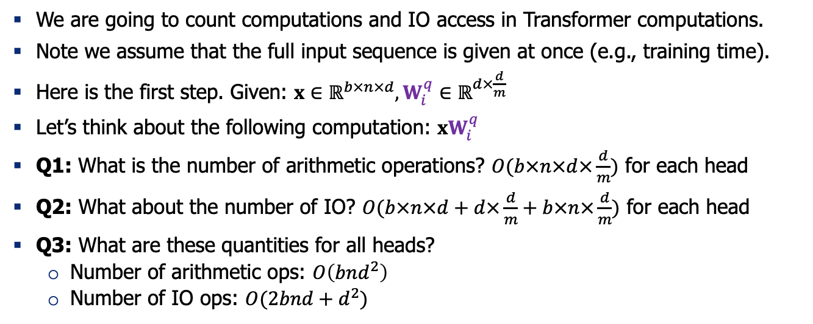
Computations in Self-Attention Block
We are going to count computations and IO access in Transformer computations.
Note we assume that the full input sequence is given at once (e.g., training time).
Here is the first step. Given: $x∈ℝ^{b×n×d},W_{i}^{q}∈ℝ^{d×\frac{d}{m}}$
Let’s think about the following computation: ${xW}_{i}^{q}$
Q1: What is the number of arithmetic operations? $O(b×n×d×\frac{d}{m})$ for each head
Q2: What about the number of IO? $O(b×n×d+d×\frac{d}{m}+b×n×\frac{d}{m})$ for each head
Q3: What are these quantities for all heads?
Number of arithmetic ops: $O\left(bnd^{2}\right)$
Number of IO ops: $O(2bnd+d^{2})$

Slide 10
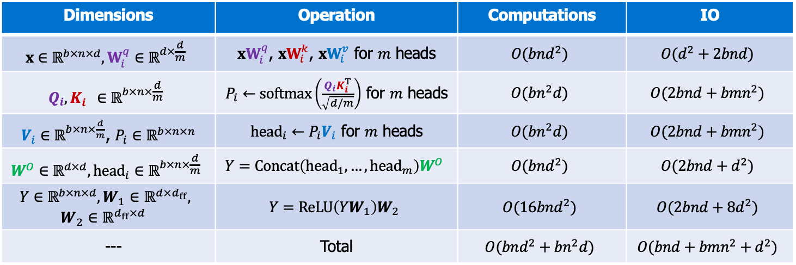
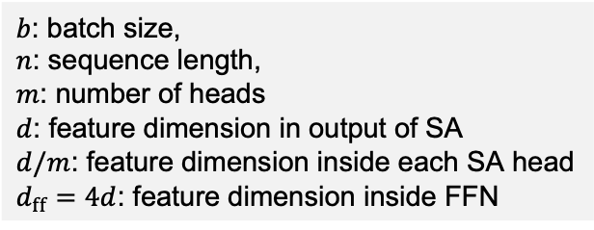
Computations in Self-Attention Block
$b$: batch size,
$n$: sequence length,
$m$: number of heads
$d$: feature dimension in output of SA
$d/m$: feature dimension inside each SA head
$d_{ff}=4d$: feature dimension inside FFN
Dimensions | Operation | Computations | IO
$$x∈ℝ^{b×n×d},W_{i}^{q}∈ℝ^{d×\frac{d}{m}}$$ | ${xW}_{i}^{q}$, ${xW}_{i}^{k}$, ${xW}_{i}^{v}$ for $m$ heads | $$O(bnd^{2})$$ | $$O(d^{2}+2bnd)$$
$$Q_{i},K_{i}^{}∈ℝ^{b×n×\frac{d}{m}}$$ | $P_{i}←softmax\left(\frac{Q_{i}K_{i}^{T}}{\sqrt{d/m}}\right)$ for $m$ heads | $$O(bn^{2}d)$$ | $$O(2bnd+bmn^{2})$$
$V_{i}∈ℝ^{b×n×\frac{d}{m}}$, $P_{i}∈ℝ^{b×n×n}$ | ${head}_{i}←P_{i}V_{i}$ for $m$ heads | $$O(bn^{2}d)$$ | $$O(2bnd+bmn^{2})$$
$$W^{O}∈ℝ^{d×d}, {head}_{i}∈ℝ^{b×n×\frac{d}{m}}$$ | $$Y=Concat\left({head}_{1}, …, {head}_{m}\right)W^{O}$$ | $$O(bnd^{2})$$ | $$O(2bnd+d^{2})$$
$$Y∈ℝ^{b×n×d},W_{1}∈ℝ^{d×d_{ff}},$$ $$W_{2}∈ℝ^{d_{ff}×d}$$ | $$Y=ReLU\left(YW_{1}\right)W_{2}$$ | $$O(16bnd^{2})$$ | $$O(2bnd+8d^{2})$$
--- | Total | $$O(bnd^{2}+bn^{2}d)$$ | $$O(bnd+{bmn^{2}+d}^{2})$$
https://le.qun.ch/en/blog/2023/05/13/transformer-batching/

Slide 11
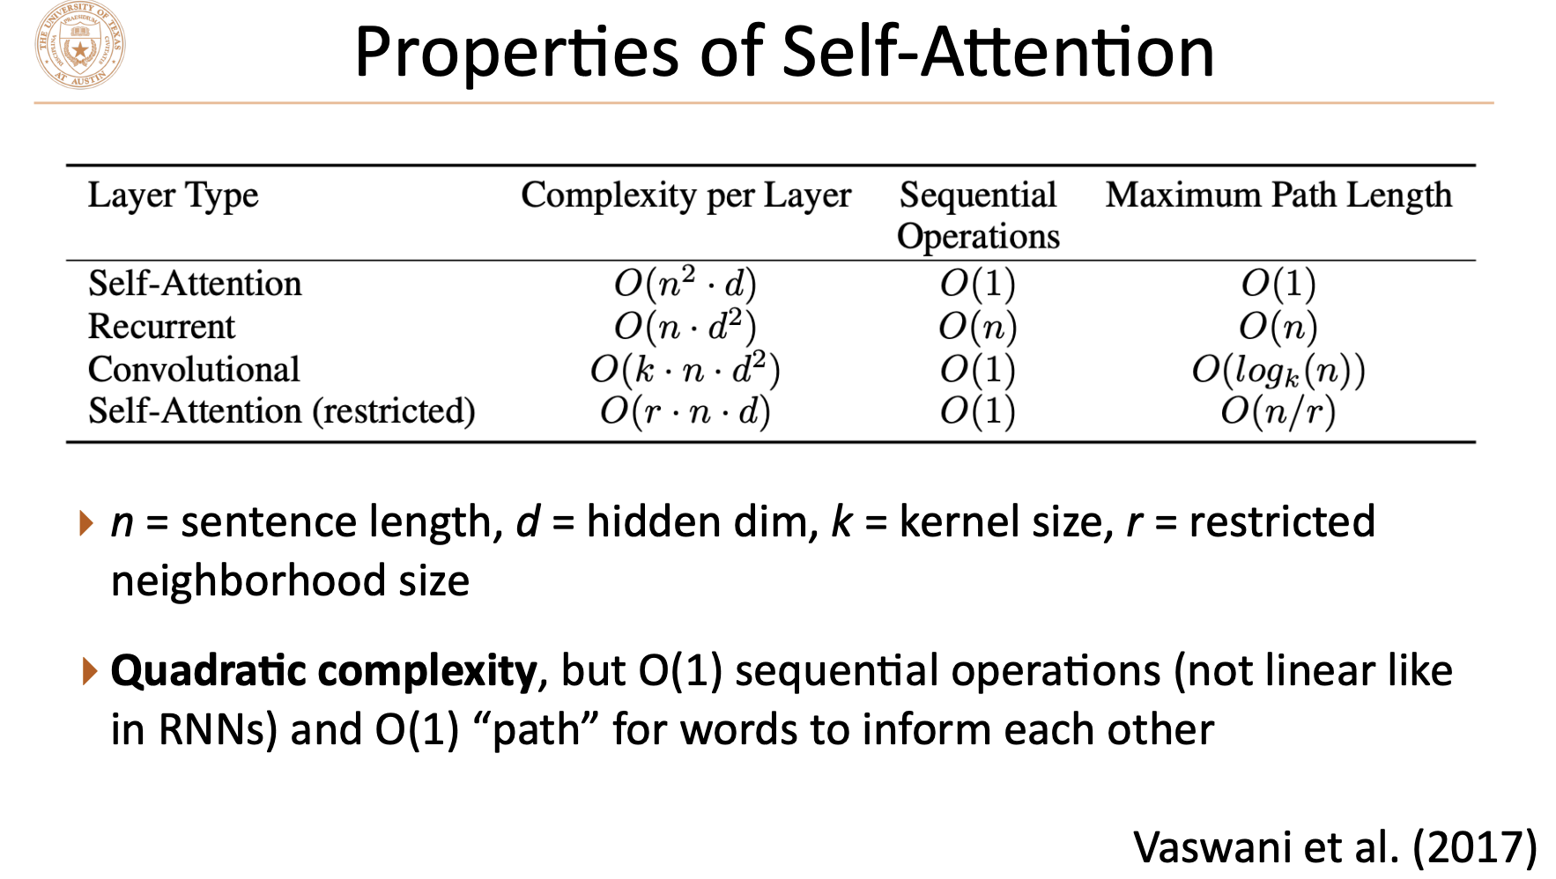
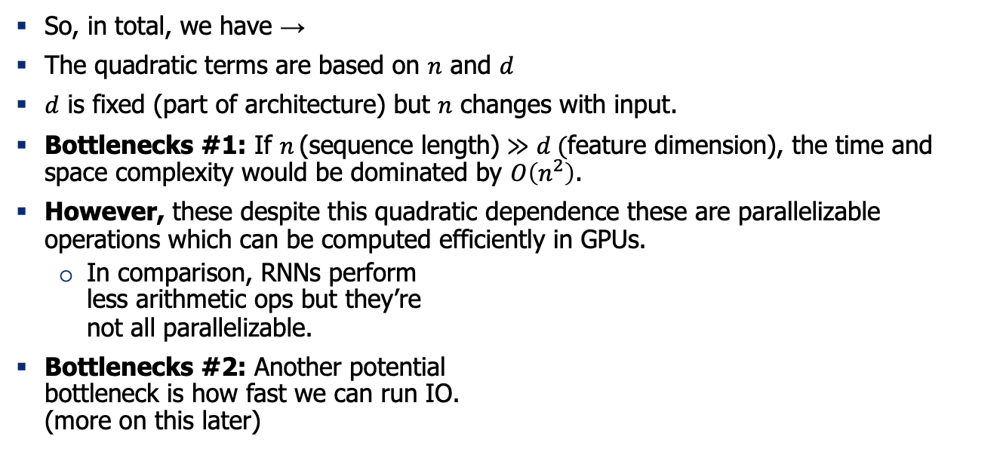
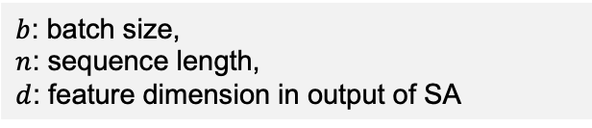
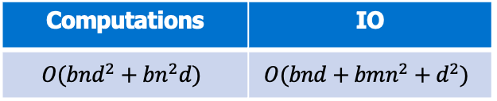
The bottlenecks
$b$: batch size,
$n$: sequence length,
$d$: feature dimension in output of SA
Computations | IO
$$O(bnd^{2}+bn^{2}d)$$ | $$O(bnd+{bmn^{2}+d}^{2})$$
So, in total, we have →
The quadratic terms are based on $n$ and $d$
$d$ is fixed (part of architecture) but $n$ changes with input.
Bottlenecks #1: If $n \text{(}\text{sequence} \text{length}\text{)}≫d (\text{feature} \text{dimension}$), the time and space complexity would be dominated by $O\left(n^{2}\right)$.
However, these despite this quadratic dependence these are parallelizable operations which can be computed efficiently in GPUs.
In comparison, RNNs perform less arithmetic ops but they’re not all parallelizable.
Bottlenecks #2: Another potential bottleneck is how fast we can run IO. (more on this later)
[Vaswani et al. 2017]
Notes:
Let’s then look at where the complexity come from. Recall the attention function …, where dim of q = dimk = Ndk. Calculation of QKt would thus cost O(N^2dk). As for the space complexity, storing the attention matrix which is this (draw) part, cost O(N2) space complexity as well, for each head. Therefore, if we have very long sequences, much longer and dk and h, the time and space cost would be quadratic to sequence length, which would be very terrible if the sequence is very long. This would have a bad impact on the scalability of the transformer, and greatly increase its resource consumption. This would also affect its adoption to all sorts of situation, such as image completion and audio recognition and so.

Slide 12
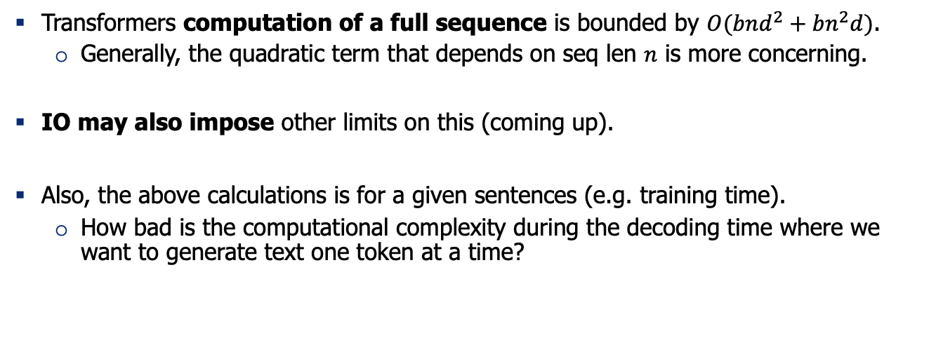
Recap
Transformers computation of a full sequence is bounded by $O(bnd^{2}+bn^{2}d)$.
Generally, the quadratic term that depends on seq len $n$ is more concerning.
IO may also impose other limits on this (coming up).
Also, the above calculations is for a given sentences (e.g. training time).
How bad is the computational complexity during the decoding time where we want to generate text one token at a time?

Slide 13
During decoding time, how slow is attention computation?

Slide 14
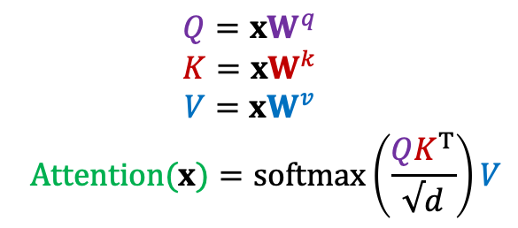
Q: Pulse Check: What is a KV-Cache?
$$Q={xW}^{q}$$
$$K={xW}^{k}$$
$$V={xW}^{v}$$
$$Attention(x)=softmax\left(\frac{{QK}^{T}}{√d}\right)V$$

Slide 15

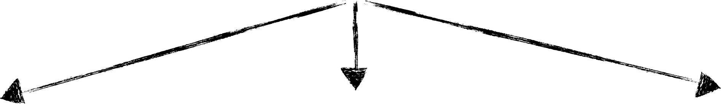



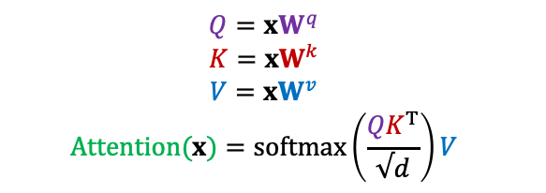
Self-Attention During Inference
$$Q={xW}^{q}$$
$$K={xW}^{k}$$
$$V={xW}^{v}$$
$$Attention(x)=softmax\left(\frac{{QK}^{T}}{√d}\right)V$$
x
q
V
K
[Slide credit: Arman Cohan]

Slide 16
Self-Attention During Inference
$$Q={xW}^{q}$$
$$K={xW}^{k}$$
$$V={xW}^{v}$$
$$Attention(x)=softmax\left(\frac{{QK}^{T}}{√d}\right)V$$
x
q
q: the next token
V
K
previous context
[Slide credit: Arman Cohan]

Slide 17
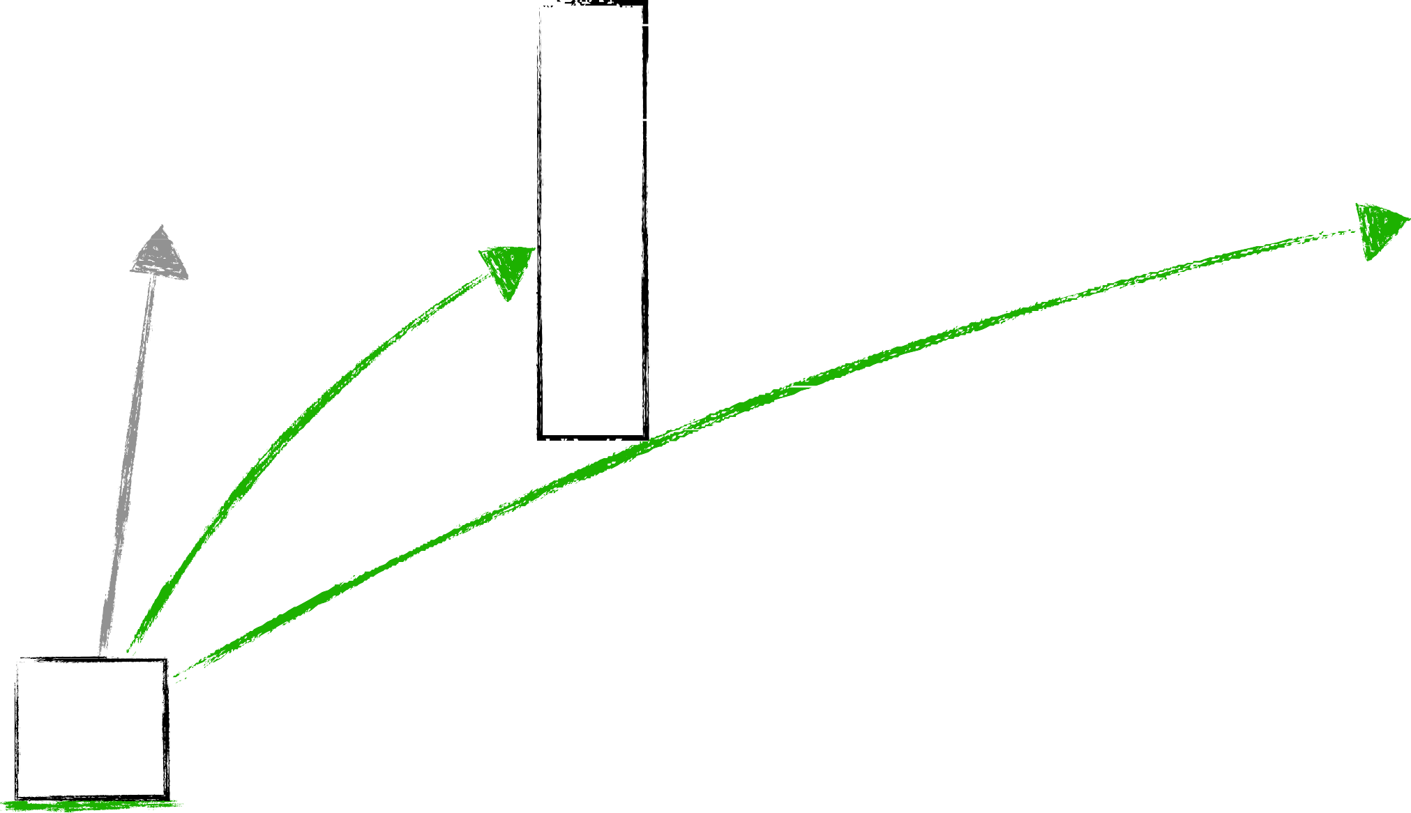

Self-Attention During Inference
$$Q={xW}^{q}$$
$$K={xW}^{k}$$
$$V={xW}^{v}$$
$$Attention(x)=softmax\left(\frac{{QK}^{T}}{√d}\right)V$$
q
K = W_{k}x
V = W_{v}x
q: the next token
previous context
The cat sat on the
[Slide credit: Arman Cohan]

Slide 18
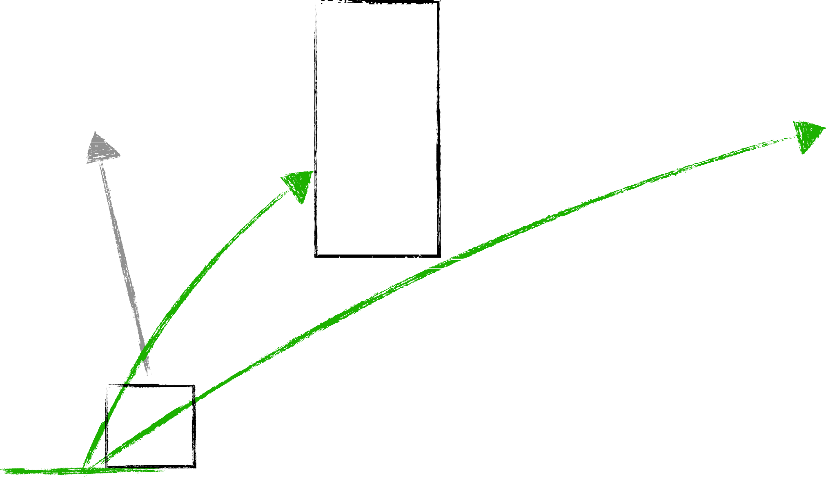

Self-Attention During Inference
$$Q={xW}^{q}$$
$$K={xW}^{k}$$
$$V={xW}^{v}$$
$$Attention(x)=softmax\left(\frac{{QK}^{T}}{√d}\right)V$$
q
K = W_{k}x
V = W_{v}x
q: the next token
previous context
The cat sat on the
[Slide credit: Arman Cohan]

Slide 19
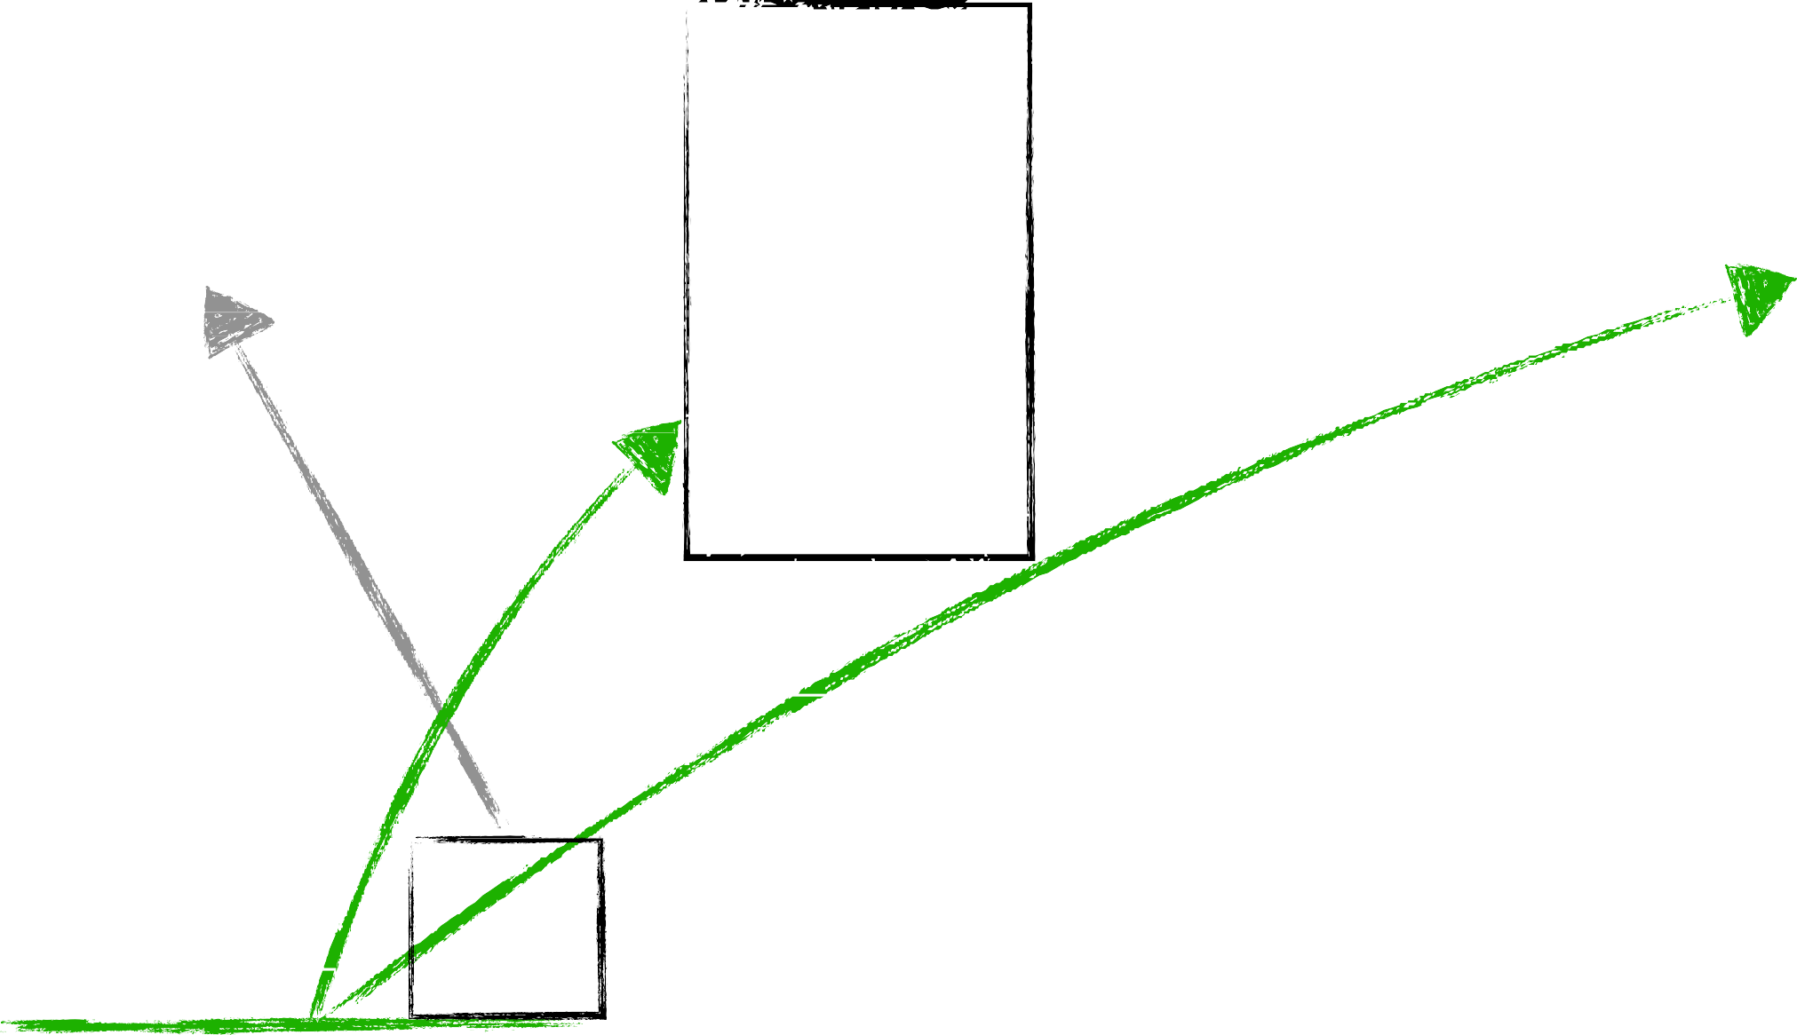

Self-Attention During Inference
$$Q={xW}^{q}$$
$$K={xW}^{k}$$
$$V={xW}^{v}$$
$$Attention(x)=softmax\left(\frac{{QK}^{T}}{√d}\right)V$$
q
K = W_{k}x
V = W_{v}x
q: the next token
previous context
The cat sat on the
[Slide credit: Arman Cohan]

Slide 20
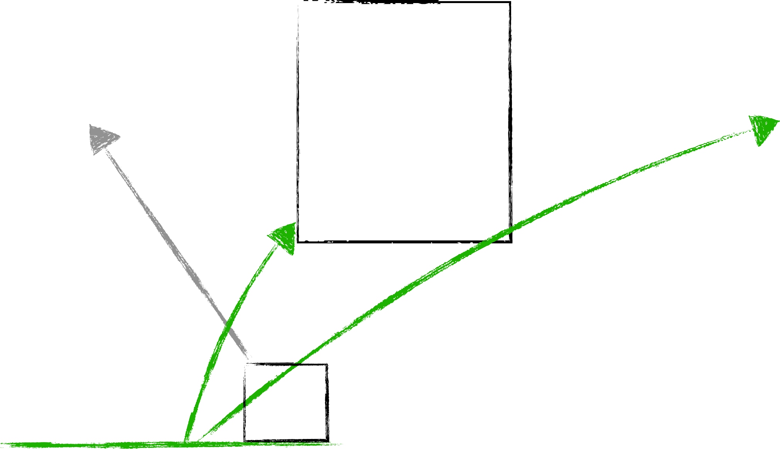
Self-Attention During Inference
$$Q={xW}^{q}$$
$$K={xW}^{k}$$
$$V={xW}^{v}$$
$$Attention(x)=softmax\left(\frac{{QK}^{T}}{√d}\right)V$$
q
K = W_{k}x
V = W_{v}x
q: the next token
previous context
The cat sat on the
[Slide credit: Arman Cohan]

Slide 21
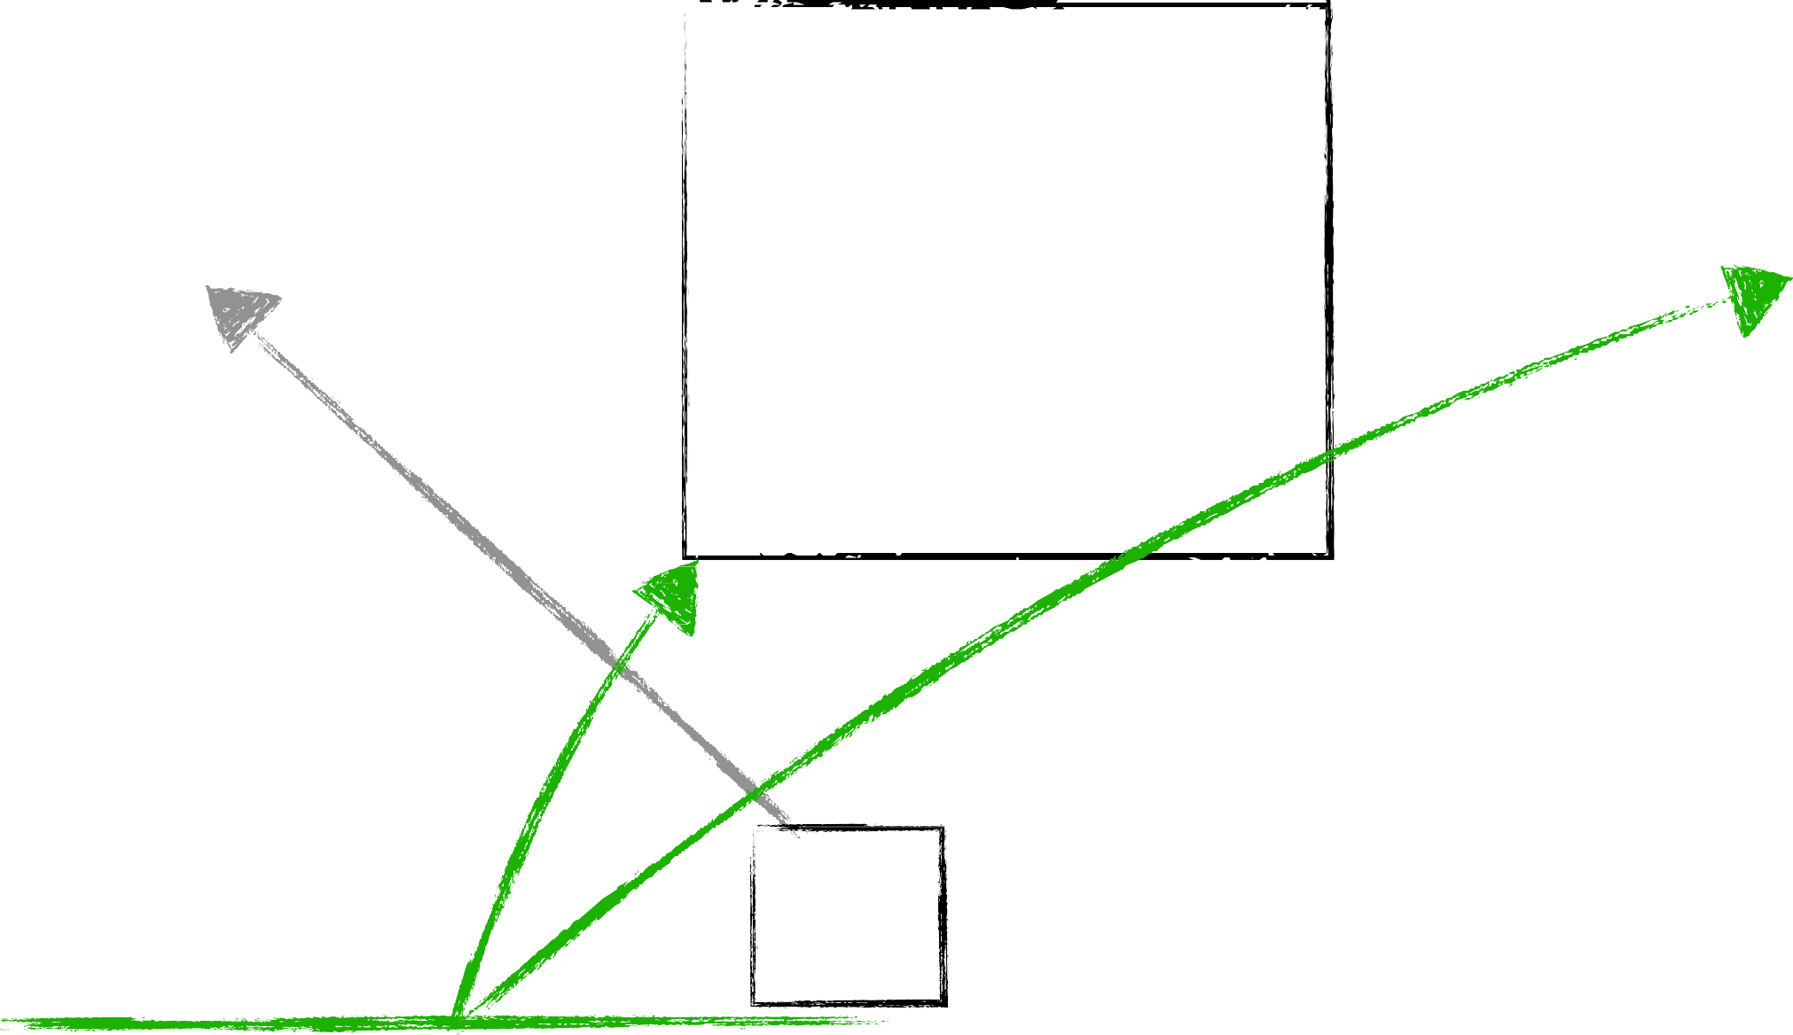

Self-Attention During Inference
$$Q={xW}^{q}$$
$$K={xW}^{k}$$
$$V={xW}^{v}$$
$$Attention(x)=softmax\left(\frac{{QK}^{T}}{√d}\right)V$$
We are computing the Keys and Values many times!
Let’s reduce redundancy! 😤
q
K = W_{k}x
V = W_{v}x
q: the next token
previous context
The cat sat on the
[Slide credit: Arman Cohan]

Slide 22
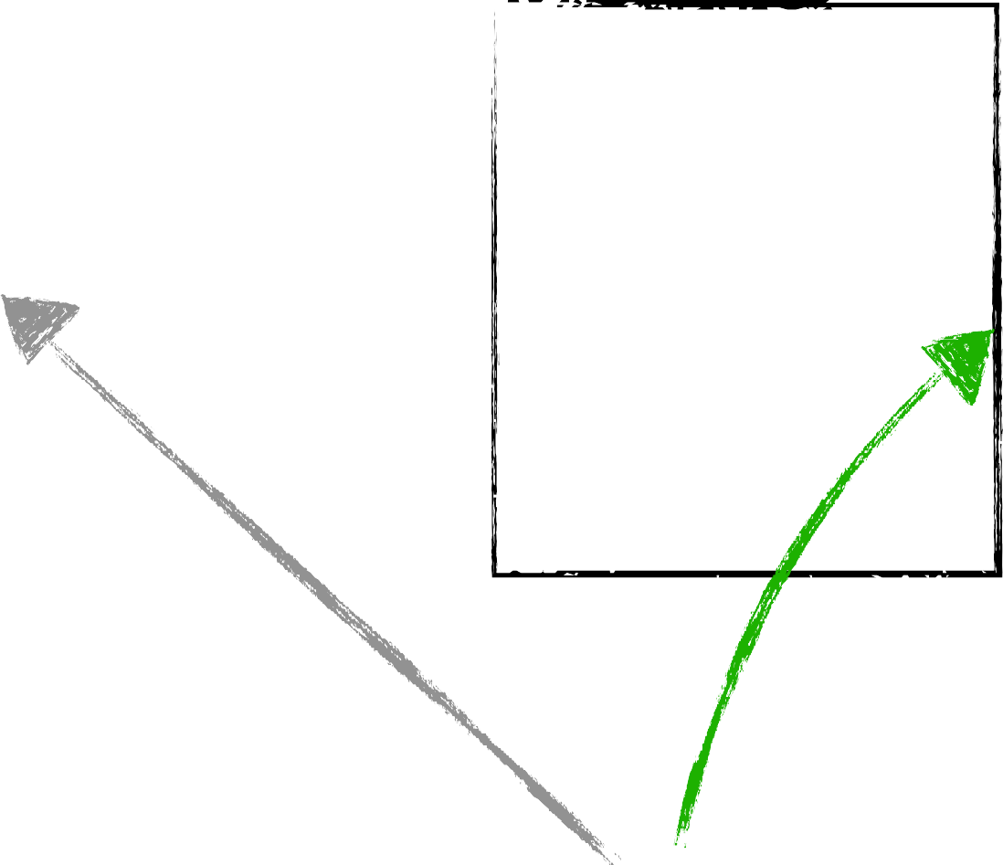


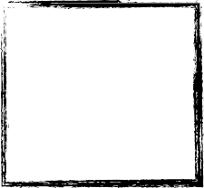
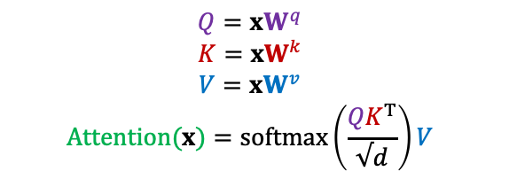
KV-Cache for reducing inference redundancy
$$Q={xW}^{q}$$
$$K={xW}^{k}$$
$$V={xW}^{v}$$
$$Attention(x)=softmax\left(\frac{{QK}^{T}}{√d}\right)V$$
We are computing the Keys and Values many times!
Let’s reduce redundancy! 😤
k_{new} = W_{k}x[: , : − 1]
q
q: the next token
V Cached
K Cached
previous context
v_{new} = W_{v}x[: , : − 1]
The cat sat on the
[Slide credit: Arman Cohan]

Slide 23
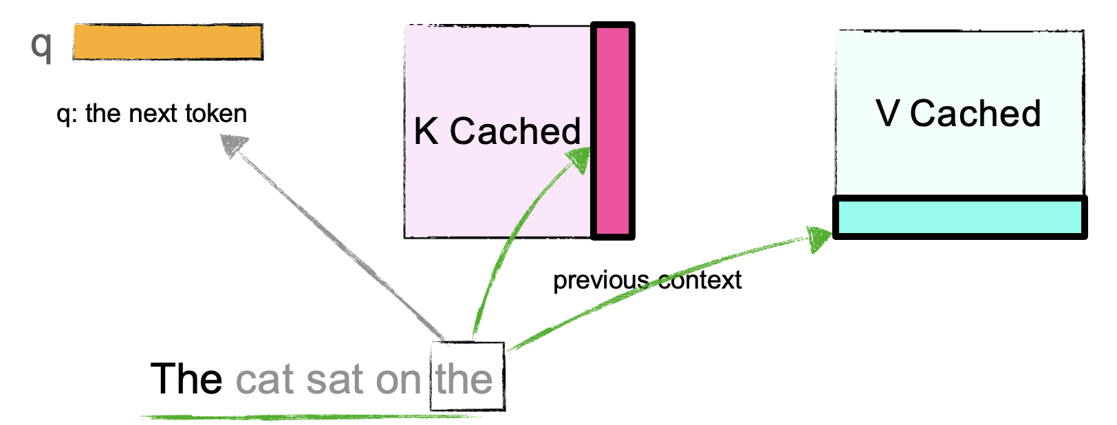
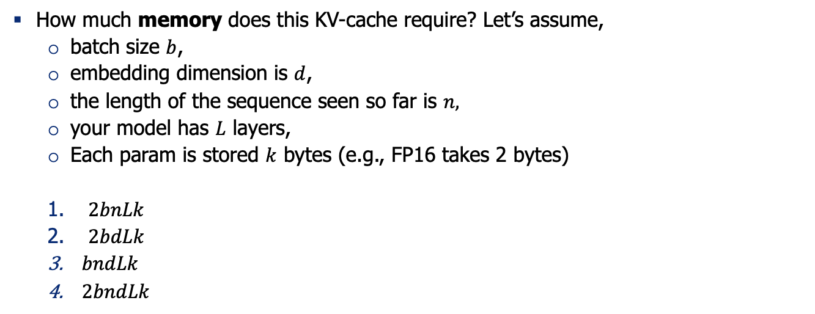
Quiz: KV-Cache
How much memory does this KV-cache require? Let’s assume,
batch size $b$,
embedding dimension is $d$,
the length of the sequence seen so far is $n,$
your model has $L$ layers,
Each param is stored $k$ bytes (e.g., FP16 takes 2 bytes)
$2bnLk$
$2bdLk$
$bndLk$
$2bndLk$

Slide 24
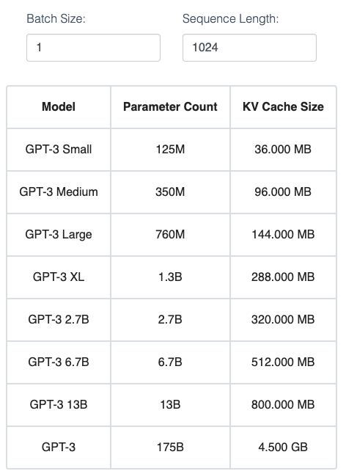
KV-Cache size
For GPT2, this comes out to a modest size of ~36 MB assuming we use the max sequence length of 1024 tokens and a batch size of 1.
For larger models, however, the KV Cache can take up GBs of memory.
Try this calculator

Slide 25
Q: Where do we store the KV Cache?
Depends.
If you’re doing single-GPU inference, it sits on the GPU that computes attention.
KV cache can be offloaded to CPU (RAM) (if GPU is running out of space) but adds latency.
Later we will revisit this discussion after seeing distributed training/inference.

Slide 26
Who has played w/ KV-Cache in practice?

Slide 27
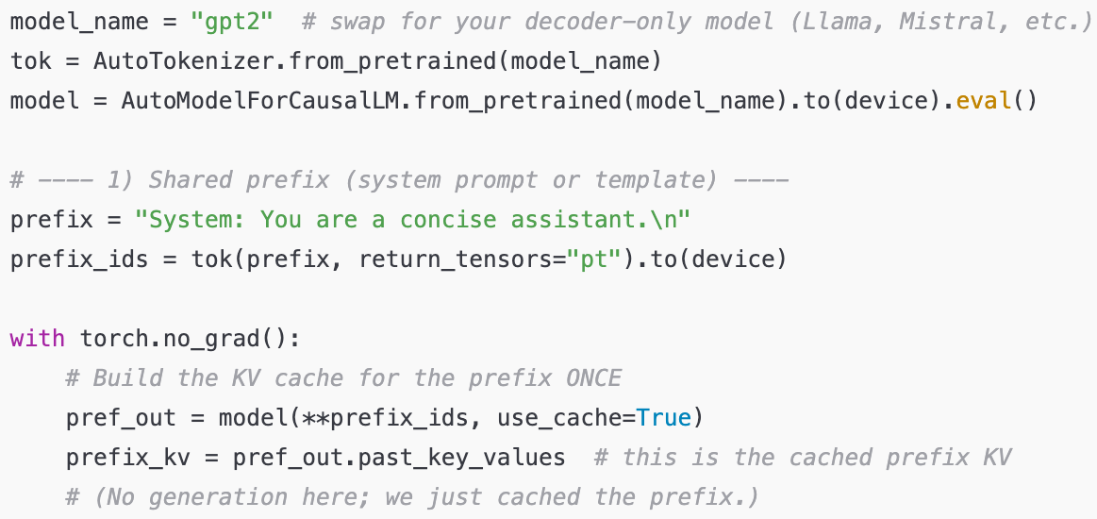
KV-Cache in practice

Slide 28
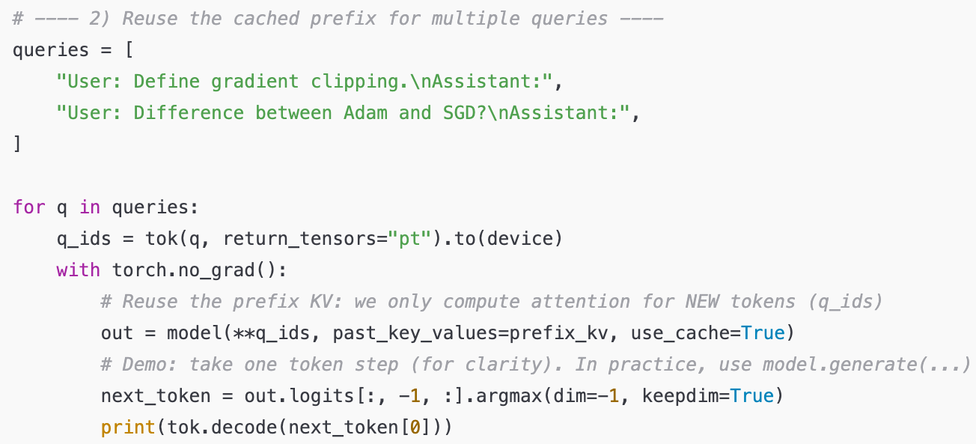
KV-Cache in practice
Note, here we don’t need to re-feed the prefix tokens (prefix_ids) to the model. Why?

Slide 29
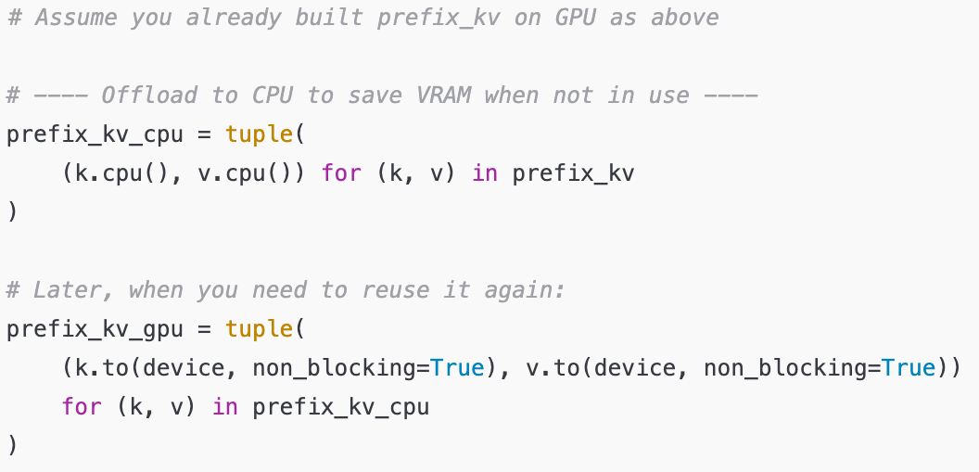
KV-Cache in practice

Slide 30

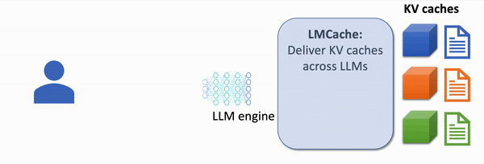
KV-cache for knowledge intensive tasks
Creative use of KV-cache can help you speed up tasks that requires repeated use of knowledge that is fixed ahead of time and may be repeated across different inputs.
For example: the task of answering questions based on retrieved documents.
Visualization from: https://lmcache.ai/

Slide 31
Recap
To avoid redundant computations during decoding time, KV-cache is used to keep track of previous calculations of keys and values.
But how exactly how costly are these computations?

Slide 32
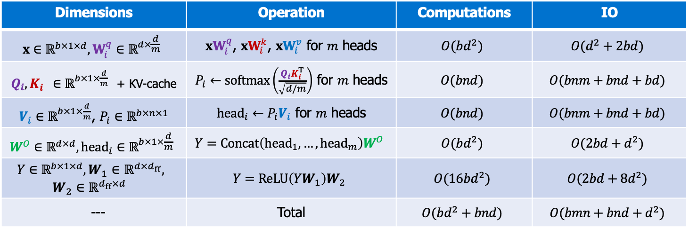
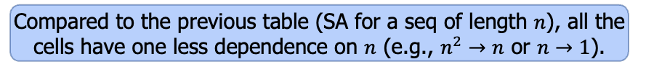
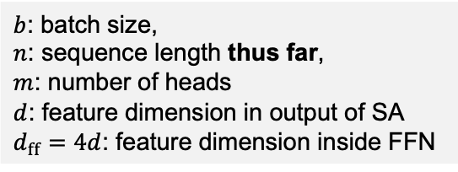
Decoding Computations
$b$: batch size,
$n$: sequence length thus far,
$m$: number of heads
$d$: feature dimension in output of SA
$d_{ff}=4d$: feature dimension inside FFN
Compared to the previous table (SA for a seq of length $n$), all the cells have one less dependence on $n$ (e.g., $n^{2}→n$ or $n→1$).
Notice we’re doing this computations for one token
Dimensions | Operation | Computations | IO
$$x∈ℝ^{b×1×d},W_{i}^{q}∈ℝ^{d×\frac{d}{m}}$$ | ${xW}_{i}^{q}$, ${xW}_{i}^{k}$, ${xW}_{i}^{v}$ for $m$ heads | $$O(bd^{2})$$ | $$O(d^{2}+2bd)$$
$Q_{i},K_{i}^{}∈ℝ^{b×1×\frac{d}{m}}$ + KV-cache | $P_{i}←softmax\left(\frac{Q_{i}K_{i}^{T}}{\sqrt{d/m}}\right)$ for $m$ heads | $$O(bnd)$$ | $$O(bnm+bnd+bd)$$
$V_{i}∈ℝ^{b×1×\frac{d}{m}}$, $P_{i}∈ℝ^{b×n×1}$ | ${head}_{i}←P_{i}V_{i}$ for $m$ heads | $$O(bnd)$$ | $$O(bnm+bnd+bd)$$
$$W^{O}∈ℝ^{d×d}, {head}_{i}∈ℝ^{b×1×\frac{d}{m}}$$ | $$Y=Concat\left({head}_{1}, …, {head}_{m}\right)W^{O}$$ | $$O(bd^{2})$$ | $$O(2bd+d^{2})$$
$$Y∈ℝ^{b×1×d},W_{1}∈ℝ^{d×d_{ff}},$$ $$W_{2}∈ℝ^{d_{ff}×d}$$ | $$Y=ReLU\left(YW_{1}\right)W_{2}$$ | $$O(16bd^{2})$$ | $$O(2bd+8d^{2})$$
--- | Total | $$O(bd^{2}+bnd)$$ | $$O(bmn+{bnd+d}^{2})$$
Query/key computations get combined with KV-cache
Now the computations (of next token) has linear dependence on seq length.
https://le.qun.ch/en/blog/2023/05/13/transformer-batching/

Slide 33
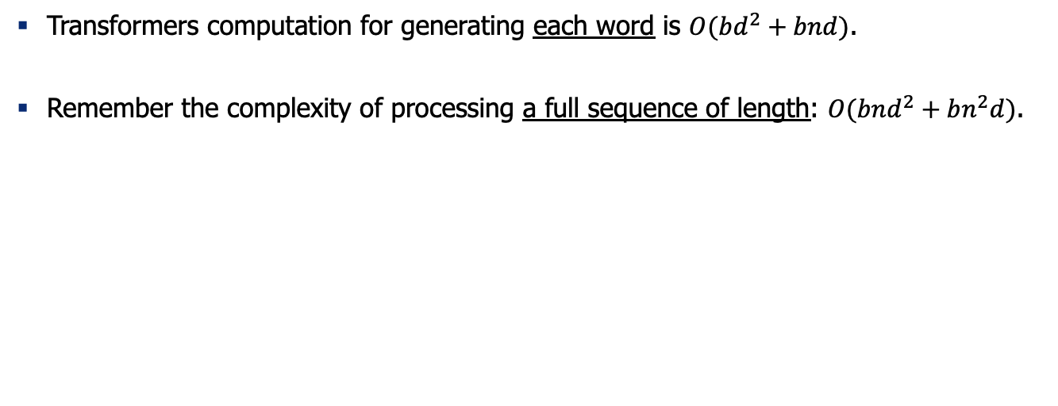
Recap: complexity of decoding text
Transformers computation for generating each word is $O(bd^{2}+bnd)$.
Remember the complexity of processing a full sequence of length: $O(bnd^{2}+bn^{2}d)$.

Slide 34
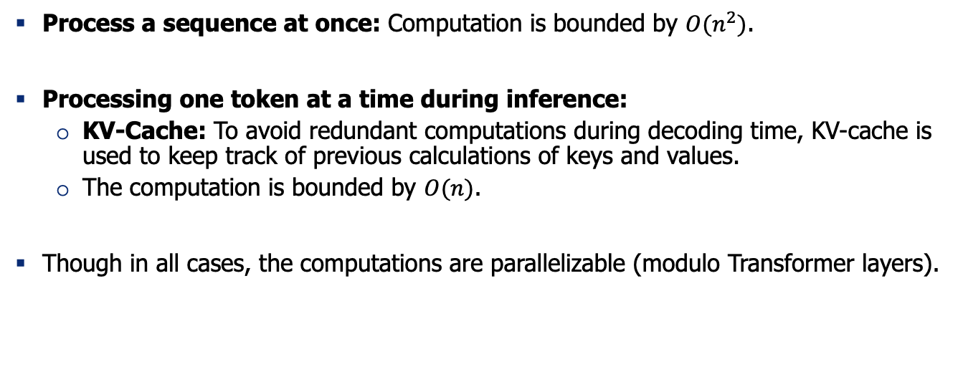
Summary: Computational Complexity of Transformers
Process a sequence at once: Computation is bounded by $O(n^{2})$.
Processing one token at a time during inference:
KV-Cache: To avoid redundant computations during decoding time, KV-cache is used to keep track of previous calculations of keys and values.
The computation is bounded by $O(n)$.
Though in all cases, the computations are parallelizable (modulo Transformer layers).

Slide 35
Thinking about compute vs IO tension

Slide 36
Diversion: Arithmetic Intensity
Arithmetic Intensity of a program execution:
(# of floating-point operations) / (# of data bytes transferred to memory)
It helps determine whether a program is compute-bound or memory-bound:
If AI is high, performance is limited by how fast the GPU can compute.
If AI is low, performance is constrained by how fast data can be transferred between global memory and GPU cores.
A good rule of thumb:
Memory-bound: AI < 10 FLOPs/byte
Balanced: 10 ≤ AI ≤ 100 FLOPs/byte
Compute-bound: AI > 100 FLOPs/byte

Slide 37
Quiz
If a model has high arithmetic intensity, which of the following is true?
A) Performance is mostly limited by memory bandwidth
B) Performance is mostly limited by compute throughput
C) Memory accesses dominate execution time
D) The workload is not well-suited for GPUs
Answer: High AI means the GPU spends more time computing per byte of memory fetched, making it compute-bound rather than memory-bound. Hence, B.

Slide 38
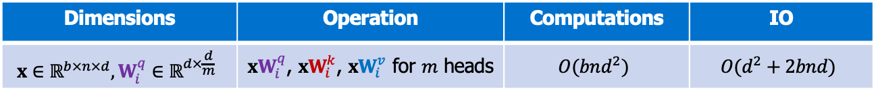
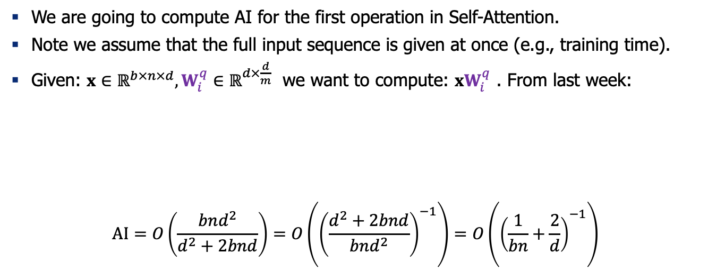
Arithmetic Intensity: An example
We are going to compute AI for the first operation in Self-Attention.
Note we assume that the full input sequence is given at once (e.g., training time).
Given: $x∈ℝ^{b×n×d},W_{i}^{q}∈ℝ^{d×\frac{d}{m}}$ we want to compute: ${xW}_{i}^{q}$ . From last week:
$$AI=O\left(\frac{bnd^{2}}{d^{2}+2bnd}\right)=O\left({\left(\frac{d^{2}+2bnd}{bnd^{2}}\right)}^{−1}\right)=O\left({\left(\frac{1}{bn}+\frac{2}{d}\right)}^{−1}\right)$$
Dimensions | Operation | Computations | IO
$$x∈ℝ^{b×n×d},W_{i}^{q}∈ℝ^{d×\frac{d}{m}}$$ | ${xW}_{i}^{q}$, ${xW}_{i}^{k}$, ${xW}_{i}^{v}$ for $m$ heads | $$O(bnd^{2})$$ | $$O(d^{2}+2bnd)$$

Slide 39
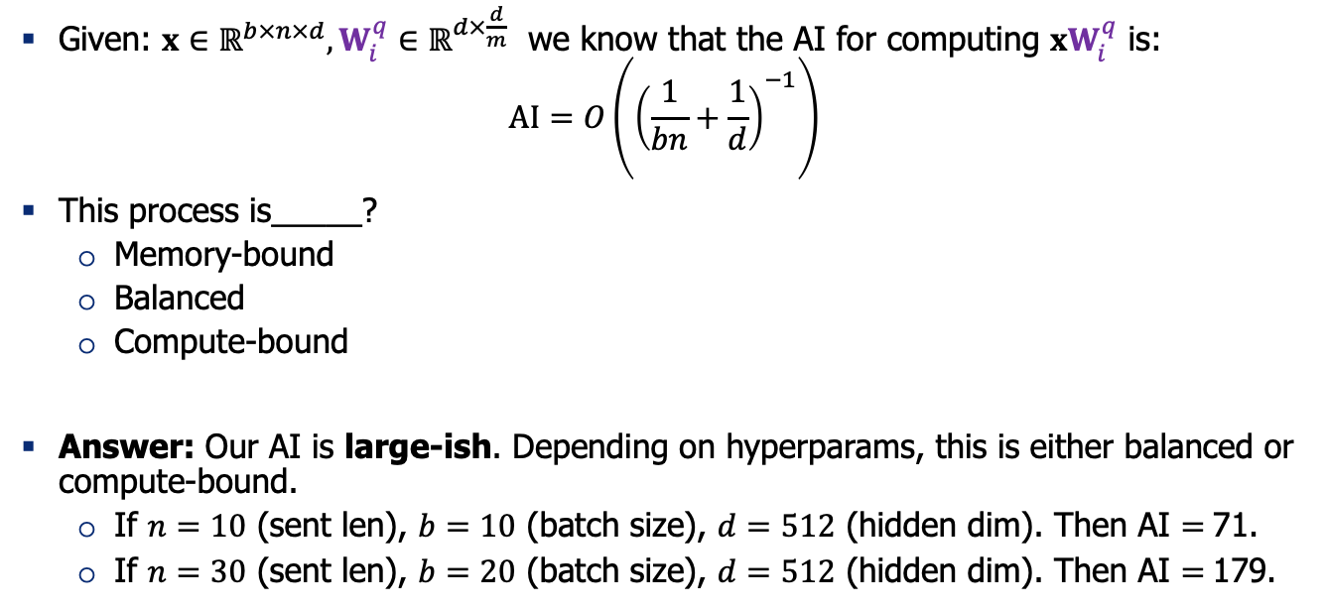
Quiz
Given: $x∈ℝ^{b×n×d},W_{i}^{q}∈ℝ^{d×\frac{d}{m}}$ we know that the AI for computing ${xW}_{i}^{q}$ is:
$$AI=O\left({\left(\frac{1}{bn}+\frac{1}{d}\right)}^{−1}\right)$$
This process is_____?
Memory-bound
Balanced
Compute-bound
Answer: Our AI is large-ish. Depending on hyperparams, this is either balanced or compute-bound.
If $n=10$ (sent len), $b=10$ (batch size), $d=512$ (hidden dim). Then AI $=$71.
If $n=30$ (sent len), $b=20$ (batch size), $d=512$ (hidden dim). Then AI $=$179.

Slide 40
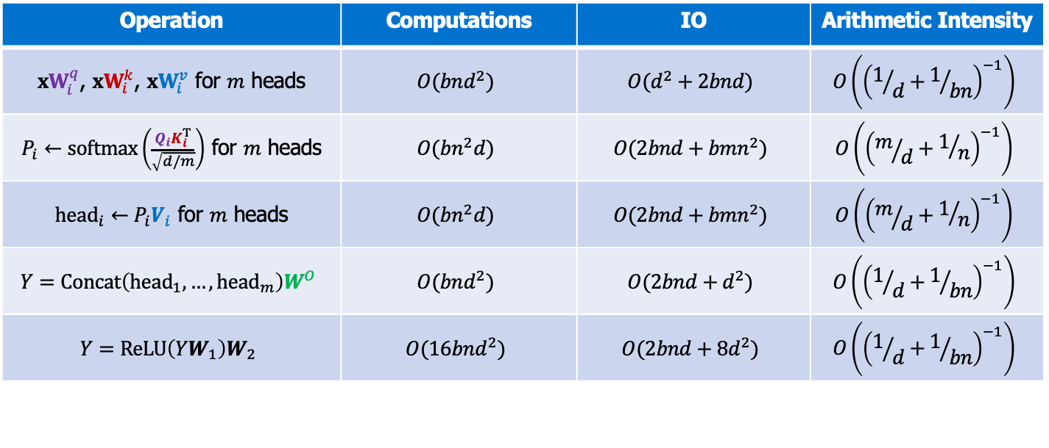
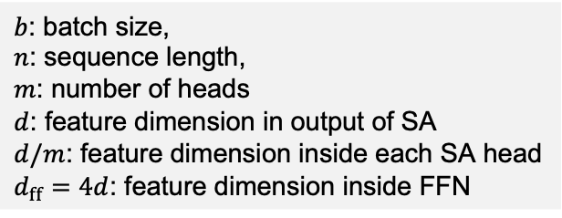
Arithmetic Intensity of Training Self-Attention
Bonus
Operation | Computations | IO | Arithmetic Intensity
${xW}_{i}^{q}$, ${xW}_{i}^{k}$, ${xW}_{i}^{v}$ for $m$ heads | $$O(bnd^{2})$$ | $$O(d^{2}+2bnd)$$ | $$O\left({\left(1/d+1/{bn}\right)}^{−1}\right)$$
$P_{i}←softmax\left(\frac{Q_{i}K_{i}^{T}}{\sqrt{d/m}}\right)$ for $m$ heads | $$O(bn^{2}d)$$ | $$O(2bnd+bmn^{2})$$ | $$O\left({\left(m/d+1/n\right)}^{−1}\right)$$
${head}_{i}←P_{i}V_{i}$ for $m$ heads | $$O(bn^{2}d)$$ | $$O(2bnd+bmn^{2})$$ | $$O\left({\left(m/d+1/n\right)}^{−1}\right)$$
$$Y=Concat\left({head}_{1}, …, {head}_{m}\right)W^{O}$$ | $$O(bnd^{2})$$ | $$O(2bnd+d^{2})$$ | $$O\left({\left(1/d+1/{bn}\right)}^{−1}\right)$$
$$Y=ReLU\left(YW_{1}\right)W_{2}$$ | $$O(16bnd^{2})$$ | $$O(2bnd+8d^{2})$$ | $$O\left({\left(1/d+1/{bn}\right)}^{−1}\right)$$
$b$: batch size,
$n$: sequence length,
$m$: number of heads
$d$: feature dimension in output of SA
$d/m$: feature dimension inside each SA head
$d_{ff}=4d$: feature dimension inside FFN
All these AI values are large! We can continue running our GPUs during training! 👍
https://le.qun.ch/en/blog/2023/05/13/transformer-batching/

Slide 41
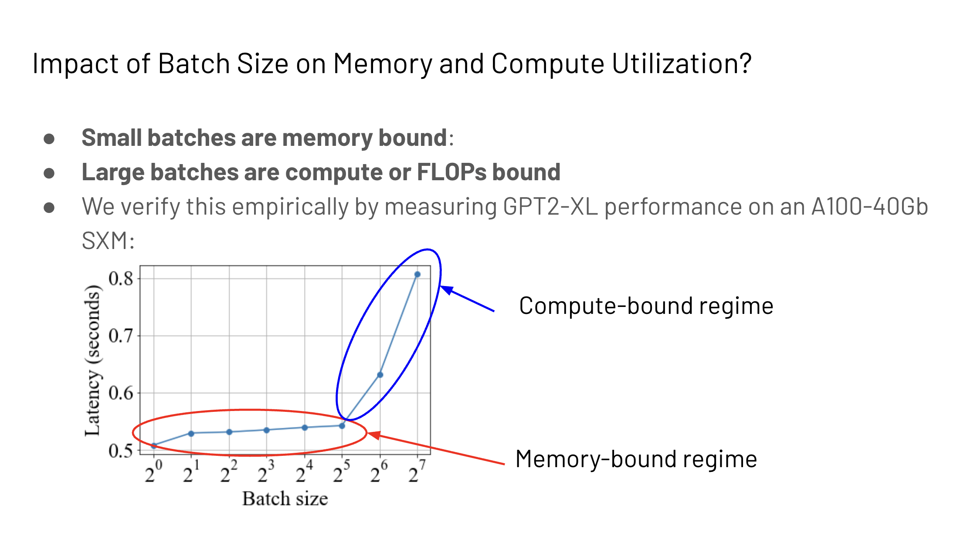

Slide 42
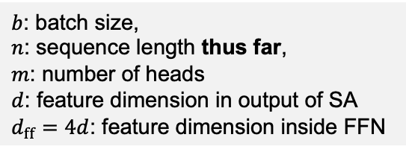
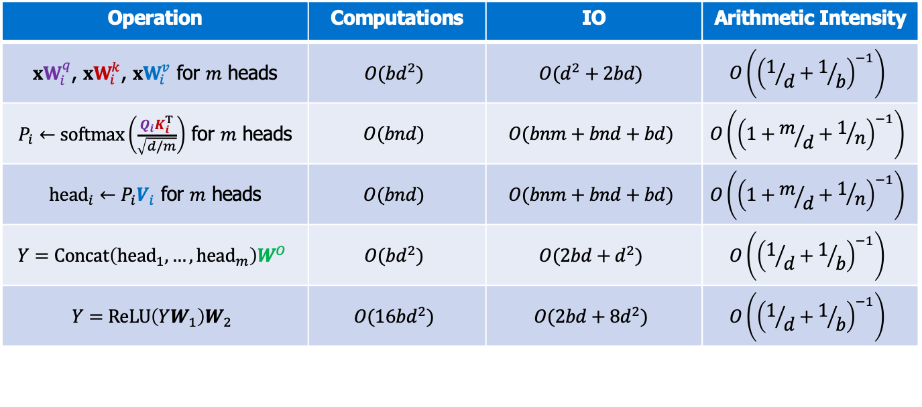
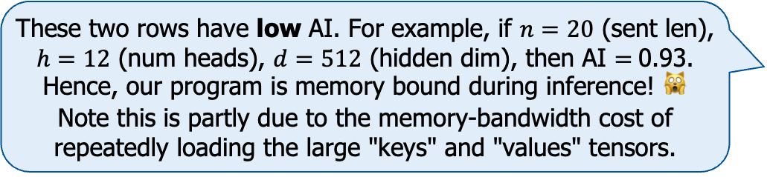
Self-Attention Cost of Computation During Incremental (Autoregressive) Generation
Bonus
Note that these numbers involve KV-caching.
Operation | Computations | IO | Arithmetic Intensity
${xW}_{i}^{q}$, ${xW}_{i}^{k}$, ${xW}_{i}^{v}$ for $m$ heads | $$O(bd^{2})$$ | $$O(d^{2}+2bd)$$ | $$O\left({\left(1/d+1/b\right)}^{−1}\right)$$
$P_{i}←softmax\left(\frac{Q_{i}K_{i}^{T}}{\sqrt{d/m}}\right)$ for $m$ heads | $$O(bnd)$$ | $$O(bnm+bnd+bd)$$ | $$O\left({\left(1+m/d+1/n\right)}^{−1}\right)$$
${head}_{i}←P_{i}V_{i}$ for $m$ heads | $$O(bnd)$$ | $$O(bnm+bnd+bd)$$ | $$O\left({\left(1+m/d+1/n\right)}^{−1}\right)$$
$$Y=Concat\left({head}_{1}, …, {head}_{m}\right)W^{O}$$ | $$O(bd^{2})$$ | $$O(2bd+d^{2})$$ | $$O\left({\left(1/d+1/b\right)}^{−1}\right)$$
$$Y=ReLU\left(YW_{1}\right)W_{2}$$ | $$O(16bd^{2})$$ | $$O(2bd+8d^{2})$$ | $$O\left({\left(1/d+1/b\right)}^{−1}\right)$$
These two rows have low AI. For example, if $n=20$ (sent len), $h=12$ (num heads), $d=512$ (hidden dim), then AI $=$0.93. Hence, our program is memory bound during inference! 🙀 Note this is partly due to the memory-bandwidth cost of repeatedly loading the large "keys" and "values" tensors.
$b$: batch size,
$n$: sequence length thus far,
$m$: number of heads
$d$: feature dimension in output of SA
$d_{ff}=4d$: feature dimension inside FFN

Slide 43
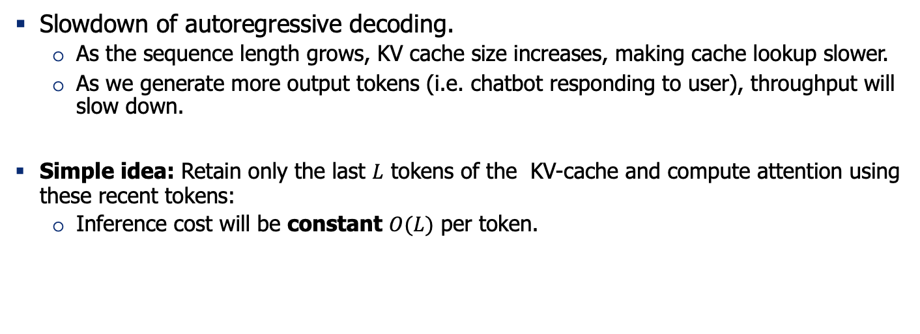
KV-Cache drag
Slowdown of autoregressive decoding.
As the sequence length grows, KV cache size increases, making cache lookup slower.
As we generate more output tokens (i.e. chatbot responding to user), throughput will slow down.
Simple idea: Retain only the last $L$ tokens of the KV-cache and compute attention using these recent tokens:
Inference cost will be constant $O(L)$ per token.

Slide 44
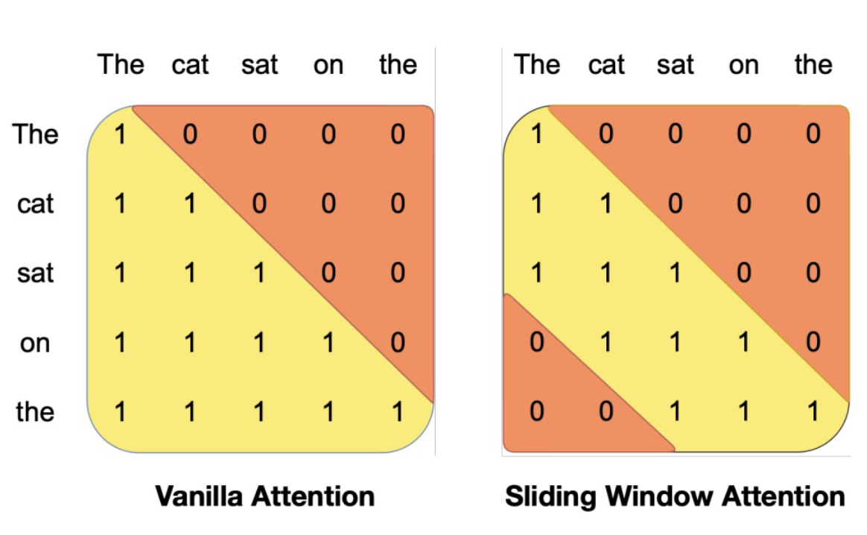
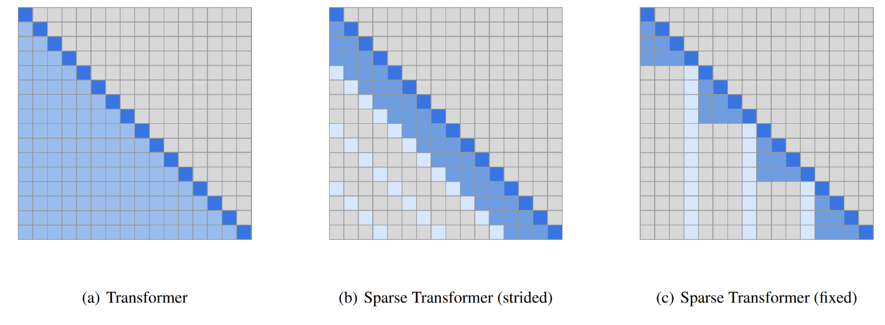
Sparse / sliding window attention
Left: Just use the main part of the strided pattern – let depth extend effective context (Mistral)
Right: Build sparse / structured attention that trades off expressiveness vs runtime.
Notable models:
GPT3 and Mistral
[Generating Long Sequences with Sparse Transformers, 2019]

Slide 45
Quiz
What are the drawbacks of sliding window?
If the model was not trained for sliding window, generation will be out-of-distribution and unstable.
If uses few layers, it’ll retains local/recent information and cannot see global context.
After a while, it will forget the input text (e.g. the original instruction provided by the user).
All of the above.
[Slide credit: Samet Oymak]

Slide 46
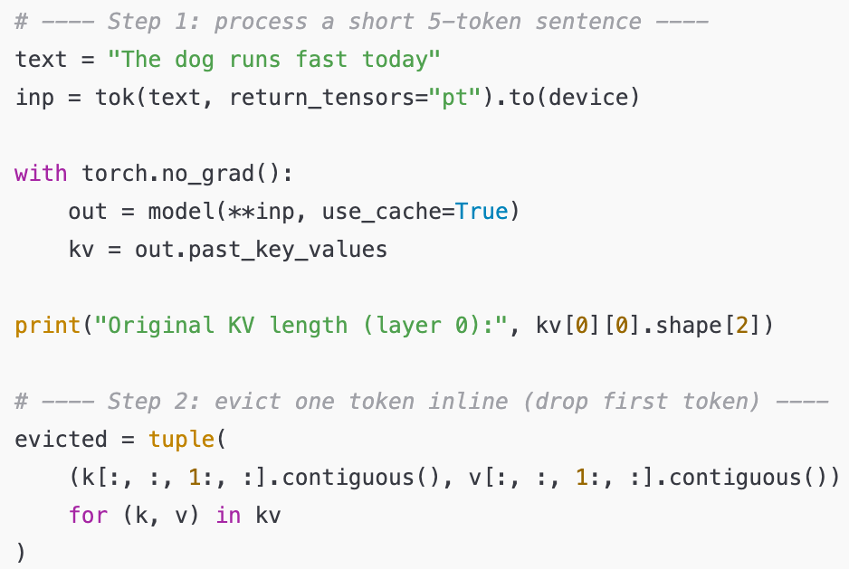
Terminology: “Eviction”
Removing old K/V pairs from the cache.
Here is a minimal example:

Slide 47

Terminology: “Eviction”

Slide 48
Examples of Last-only window
Prompt: The kid is wearing a red shirt,
Input length: 24, Output length: 49
KV Cache: unlimited -> Generated: The kid is wearing a red shirt, a blue hat, and green pants. The kid's shirt's color is red, the hat's color is blue, and the pants' color is green.
KV Cache: last_50 -> Generated: The kid is wearing a red shirt, a blue hat, and green pants. The kid's shirt's color is red. This is a picture of a kid in a red shirt, a blue hat, and green pants.
KV Cache: last_20 -> Generated: The kid is wearing a red shirt, a blue hat, and green pants. The kid's shirt's color is a red shirt's'!!!!!!!!!!!!!!!!;!!
KV Cache: last_10 -> Generated: The kid is wearing a red shirt, a blue hat, and green pants. The kid's shirt's color is is is is is's's's's's's's's'ss's }s's c, and and and
[Example credit: Sungwon Kim]

Slide 49

Sliding Window Attention with “Sinks”
Observations: There are few tokens (“sinks”) that the model heavily relies on.
These sink tokens (e.g., BOS) consistently receive high attention.
Removing them leads to unstable generation.
Figure: In most layers, SA heavily attends to the initial token across all heads. (the bottom two layers don’t always show this).
Why? Complicated. One explanation is, when no meaningful tokens attract attention, the model must still distribute probability mass somewhere (e.g., uninformative tokens. (note SA has to be a proper probability)
[Efficient Streaming Language Models with Attention Sinks, 2023]

Slide 50


Sliding Window Attention with “Sinks”
If you use sliding window, without retraining, your attention values will be distorted.
StreamingLLM always maintains few initial positions (sinks).
[Efficient Streaming Language Models with Attention Sinks, 2023]

Slide 51
Examples of Caching the ”sinks” (last+first)
Prompt: The kid is wearing a red shirt,
Input length: 24, Output length: 49
KV Cache: unlimited -> Generated: The kid is wearing a red shirt, a blue hat, and green pants. The kid's shirt's color is red, and the kid's hat's color is blue. The kid's pants' color is green. The kid is wearing
KV Cache: first3+last_20 -> Generated: The kid is wearing a red shirt, a blue hat, and green pants. The kid's shirt's color is red. The kid's color is red. The kid's color. The kid's red. Kid's red is. is
KV Cache: first3+last_10 -> Generated: The kid is wearing a red shirt, a blue hat, and green pants. The kid's shirt's color is a white shirt with a black and red and white and orange collar and blue and green with a black on each side of the
KV Cache: first3+last_5 -> Generated: The kid is wearing a red shirt, a blue hat, and green pants. The kid's shirt's color is the most important part of the company is the home, so as to be sure that you are on the home and you are
[Example credit: Sungwon Kim]

Slide 52
Prefix Caching
(or, prompt caching)

Slide 53
Prefix Caching
Many prompts (e.g., from different users) share the same prefix.
<System> You are a helpful assistant … <System>
<User> I want to know how can I use the coffee machine <User>
<System> You are a helpful assistant … <System>
<User> Write the code for training my language model. <User>
<System> You are a helpful assistant … <System>
<User> Help me revise my email ... <User>

Slide 54
Prefix Caching
Prefix caching means reusing the KV cache from a shared prefix of tokens across multiple inference runs or generations, instead of recomputing it.
Most libraries (e.g., vLLM) have this feature implemented:
enable_prefix_caching=True
<System> You are a helpful assistant … <System>
Prefix Cache
CPU or GPU
But, can we slice the activations to fit them in different GPUs?
- Yes, by Tensor Parallelism

Slide 55


Prefix Caching
Can accelerate one user using multiple language models.
Different users using one language models.
Visualization from: https://lmcache.ai/

Slide 56
Architecture change to reduce IO

Slide 57


Multi-Query Attention (MQA)
The idea is to reduce the memory-bandwidth cost of repeatedly loading the large "keys" and "values" tensors.
Key idea – have multiple queries, but just one dimension for keys and values.
Small PPL w/ MQA [Shazeer 2019]

Slide 58


MQA in practice
Bonus
Script

Slide 59
Grouped Query-Attention (GQA)
Notable models:
Llama 2, Mistral, Qwen2
An interpolation between “multi-head” attention and “multi-query” attention.
Simple knob to control expressiveness (key-query ratio) and inference efficiency
GQA: Training generalized multi-query transformer models from multi-head checkpoints, 2023

Slide 60


Grouped Query-Attention (GQA)
Does it actually work? Depends.
Output quality of various models; all these SA variants are on-par on quality.
Inference speed as a function of GQA group size — 8 heads gives you inference speed as good as 1 head!
GQA: Training generalized multi-query transformer models from multi-head checkpoints, 2023

Slide 61

Roofline model
Bonus
https://le.qun.ch/en/blog/2023/05/13/transformer-batching/
https://crd.lbl.gov/assets/Uploads/ECP20-Roofline-1-intro.pdf

Slide 62
Recap
SA’s AI during inference is not good.
We’re doing a lot of IO relative to computations (KV drag).
Sliding window attention: sparsifying attention pattern by looking at nearby things.
MQA and GQA: sharing attention keys and values.

Slide 63
Do you the dimensions of my latent embeddings?

Slide 64

Low-Rank Key-Value Joint Compression
Joint compress (project) keys and values to reduce KV cache:
DeepSeek-V2: A Strong, Economical, and Efficient Mixture-of-Experts Language Mode, 2024

Slide 65


Low-Rank Key-Value Joint Compression
Joint compress (project) keys and values to reduce KV cache:
DeepSeek-V2: A Strong, Economical, and Efficient Mixture-of-Experts Language Mode, 2024

Slide 66

MLA: KV-Cache size comparison
MLA’s KV cache size is equal to GQA with only 2.25 groups. How about its performance? (vs. MHA and GQA)
DeepSeek-V2: A Strong, Economical, and Efficient Mixture-of-Experts Language Mode, 2024

Slide 67

MLA: KV-Cache size comparison
MLA (DeepSeek-V2) shows better performance than MHA, but requires a significantly smaller amount of KV cache.
DeepSeek-V2: A Strong, Economical, and Efficient Mixture-of-Experts Language Mode, 2024

Slide 68
Recent variation: Native Sparse Attention
Native Sparse Attention from deepseek, which performs attention in a block level rather than in a token level. Intuitively, this means that the model learns which chunk / paragraph is important rather than which token is important.
Incorporate: https://arxiv.org/pdf/2502.11089
Native Sparse Attention: Hardware-Aligned and Natively Trainable Sparse Attention, 2025

Slide 69
Quantization

Slide 70

Quantization: Mapping from high to low precision
In deep learning, this process lets models run faster with less memory by storing weights/activations in lower precision (e.g., FP16 or INT8).

Slide 71

Numeric Data Types: FP32
32-bit floating point number or FP32 (IEEE 754)
Range
Precision

Slide 72

Numeric Data Types: FP32 (example)
This bit string corresponds to what number? 11000000110110000000000000000000
Split first:
Sign = 1
Exponent = ${\left(\text{10000001}\right)}_{2}={\left(129\right)}_{10}$
1+ Fraction: ${\left(\text{1.}\text{10110000000000000000000}\right)}_{2}={\left(\text{1.}\text{1011}\right)}_{2}=1+0.5+0.125=0.0625=1.6875$
So, in total: ${\left(−1\right)}^{1}×1.6875 ×2^{(129−127)}=−0.6.75$

Slide 73

Floating Point Numbers: Range vs Precision
Floating-point design is always a trade-off between range and precision
and this trade-off is central to quantization and mixed-precision computing.

Slide 74

Floating Point Numbers
Different floating-point formats used in machine learning, showing how they trade range and precision based on how many bits are allocated to the exponent and fraction (mantissa).
More range, less precision

Slide 75

Range vs Precision
https://newsletter.maartengrootendorst.com/p/a-visual-guide-to-quantization

Slide 76

More examples
https://newsletter.maartengrootendorst.com/p/a-visual-guide-to-quantization

Slide 77

More examples
https://newsletter.maartengrootendorst.com/p/a-visual-guide-to-quantization

Slide 78
During training LLMs, what numeric type is used where?
Component | Typical Precision | Purpose / Reason | Notes
Model Parameters | BF16 / FP16 | Reduce memory use and training bandwidth while maintaining adequate range | BF16 preferred (same exponent range as FP32, avoids loss scaling)
Activations | BF16 / FP16 | Efficient representation of large tensors during forward/backward passes | Some ops (e.g., softmax, attention) temporarily use FP32 for stability
Gradients | FP32 | Prevent precision loss when summing many small updates | Down-cast to BF16/FP16 when applying updates
Optimizer States (e.g., Adam m/v) | FP32 | Maintain stable parameter updates across steps | Typically 2–3× the memory of model weights
Checkpoint Storage | BF16 / FP32 | Preserve accuracy and reproducibility | Mixed-precision checkpoints often store FP32 master weights

Slide 79


Example: LLama3 paper
The Llama 3 Herd of Models

Slide 80

Example: LLama3 paper
Qwen tech report, 2023

Slide 81
Terminology: “Full Precision"
“Floating point” refers to how numbers are stored
“Full precision” usually means 32-bit floating point (FP32) — the traditional standard for numerical accuracy in deep learning and scientific computing.
Term | Meaning | Example
Floating point | Numeric format that represents real numbers using sign, exponent, mantissa | FP32, FP16, BF16
Full precision | Highest-precision floating-point format commonly used in training | FP32

Slide 82

Linear Quantization
Linear quantization maps continuous floating-point values to discrete integer levels using a uniform step size.
32 FP
2-bit signed integer (int2)

Slide 83

Linear Quantization
Linear quantization maps continuous floating-point values to discrete integer levels using a uniform step size.
The uniform step size is defined by a scale and zero-point.
How to find these numbers?​

Slide 84

Linear Quantization

Slide 85

Linear Quantization: Scale
The top line (r) represents the original floating-point range.
The bottom line (q) represents the quantized integer rang
Quantization and Training of Neural Networks for Efficient Integer-Arithmetic-Only Inference (Jacob et al., CVPR 2018)

Slide 86

Linear Quantization: Zero Point
The top line (r) represents the original floating-point range.
The bottom line (q) represents the quantized integer rang
“Round” because Z must be an integer
Quantization and Training of Neural Networks for Efficient Integer-Arithmetic-Only Inference (Jacob et al., CVPR 2018)

Slide 87

Linear Quantization: Zero Point
In practice, weights are usually centered around zero.
Hence, we can set Z=0.
Quantization and Training of Neural Networks for Efficient Integer-Arithmetic-Only Inference (Jacob et al., CVPR 2018)

Slide 88

Linear Quantization: Zero Point
Called absmax or absolute maximum quantization
In practice, weights are usually centered around zero.
Hence, we can set Z=0.
This means that our formula for scale will be much simpler:
Quantization and Training of Neural Networks for Efficient Integer-Arithmetic-Only Inference (Jacob et al., CVPR 2018)

Slide 89

Quantization of LLMs
What is an LLM?
Weights
Input
Their confluence result in activations, and ultimately outputs.
Weights are static and known in-advance.
Activations change based on input.

Slide 90
Quantization of LLMs: Weight vs Activations
Aspect | Weights | Activations
Nature | Static, known before inference | Dynamic, varies with input and layer outputs
Timing | Quantized offline (PTQ or QAT) | Quantized on-the-fly during inference
Distribution | Stable, near-zero symmetric | Variable, often skewed with large outliers
Precision | Lower (4–8 bit) | Higher (8–16 bit) to preserve range
Zero Point | Often symmetric (Z = 0) | Often asymmetric (non-zero mean)
Common Methods | GPTQ, AWQ | SmoothQuant, ZeroQuant

Slide 91

Quantization of LLM Activations: Outliers
The plot shows activation ranges (i.e., min–max spread) for each output channel (dimension) in the first layer of MobileNetV2.
There exists many outliers in activations!
Data-Free Quantization Through Weight Equalization and Bias Correction (Kagel et al., ICCV 2019)

Slide 92
Quantization of LLM Activations : Outliers
The plot shows activation ranges (i.e., min–max spread) for each output channel (dimension) in the first layer of MobileNetV2.
There exists many outliers in activations!
It’s not just about having large range: these large numbers are rare but important.

Slide 93

Quantization of LLM Activations: Per-Channel Quantization
With outliers means you have a very large range.
As a result, you lose precision in your quantization (a limited number of bits to represent a wide range of numbers)
Data-Free Quantization Through Weight Equalization and Bias Correction (Kagel et al., ICCV 2019)

Slide 94
Quantization of LLM Activations: Per-Channel Quantization
One mitigation is to quantize each channel individually; so each channel gets its own scale and zero-point!
This greatly reduces the outlier problem—but doesn’t eliminate it entirely.
Outliers within a single channel can still distort that channel’s range.
When outliers stretch the quantization range, we end up allocating most of our bits to represent the wide middle region between typical and extreme values, a range that rarely occurs in practice.

Slide 95

Quantization of LLM Activations: Ignoring Outliers?
Ignoring the outliers (skipping them in quantization) significantly harms performance after quantization in LMs.
LLM.int8(): 8-bit Matrix Multiplication for Transformers at Scale (Dettmers et al., NeurIPS 2022)

Slide 96

Quantization of LLM Activations
Outlier features significantly harms performance after quantization in LMs.
LLM.int8(): 8-bit Matrix Multiplication for Transformers at Scale (Dettmers et al., NeurIPS 2022)

Slide 97

Quantization of LLM Activations: LLM.int8()
Keep outlier channels in 16-bit, quantize the remaining channels.
LLM.int8(): 8-bit Matrix Multiplication for Transformers at Scale (Dettmers et al., NeurIPS 2022)

Slide 98

Quantization of LLM Activations: LLM.int8()
Zeropoint > absmax because outliers can be non-symmetric (either very large or very small, but not both)
LLM.int8(): 8-bit Matrix Multiplication for Transformers at Scale (Dettmers et al., NeurIPS 2022)

Slide 99

Quantization of LLM Activations: LLM.int8()
Under the hood, this calls bitsandbytes’ implementation of LLM.int8() which automatically detects and handles outlier channels,

Slide 100
Quantization of LLMs: Recap
Quantization maps high-precision numbers (FP32, FP16, BF16) to lower-precision formats (FP8, INT8) to save memory and speed up computation.
Used in both training and inference to reduce memory footprint and bandwidth.
Main challenge: handling outliers in activations that can distort the quantization range.
Modern methods (e.g., SmoothQuant, LLM.int8()) mitigate outlier effects to maintain accuracy.

Slide 101
Quantization during training or after?
PTQ dominates real-world LLM deployment due to its simplicity and efficiency, while QAT is reserved for cases where extreme compression or minimal accuracy loss is critical.
Method | Description | Pros | Cons | Usage in Practice
Post-Training Quantization (PTQ) | Quantizes weights/activations using calibration data without retraining | Fast, simple, no retraining needed | Accuracy may drop, especially below 8-bit | Most common — used in nearly all LLM inference pipelines (e.g., LLM.int8(), GPTQ, AWQ, SmoothQuant)
Quantization-Aware Training (QAT) | Simulates quantization noise during training to help the model adapt | Best accuracy, robust at 4-bit or lower | Requires retraining/fine-tuning, slower | Less common — used in research or special cases targeting ultra-low precision

Slide 102
Incorporate
https://newsletter.maartengrootendorst.com/p/a-visual-guide-to-quantization
https://nanotron-ultrascale-playbook.static.hf.space/index.html#first_steps:_training_on_one_gpu

Slide 103
Distributed Training & Inference

Slide 104
Motivation
How much GPU memory (at least) do we need to perform inference/training?
(batch size=1, ignoring the KV cache and optimizer states)
Model Size (Llama 3 architecture) | Inference Memory (~2x model size) | Training Memory (~7x model size)
8B | 16GB | 60GB
70B | 140GB | 500GB
405B | 810GB | 3.25TB
Source: https://huggingface.co/blog/llama31#inference-memory-requirements

Slide 105

Where did all the memory go?
Longer sequences require much more memory in training!
Training Sequence Length (Number of Tokens)
Source: https://nanotron-ultrascale-playbook.static.hf.space/dist/index.html

Slide 106
Model Efficiency: Topics
Distributed Training
Quantization (Post Training Quantization)
Distillation
Chapter goal: Getting comfortable with various mathematical and systems foundations for efficient deployment of LLMs.

Slide 107


Distributed Training and Inference
Naïve Data Parallelism
Sharding Optimizer States (ZeRO, FSDP)
Model Parallelism (Tensor Parallelism, Pipeline Parallelism)
GPU 0
Model Copy
GPU 2
Model Copy
GPU 3
Model Copy

Slide 108
Brief on GPU Operations for Communicating Tensors

Slide 109

NCCL: NVIDIA Collective Communication Library
Pronounced "Nickel”!!
NCCL provides routines to send and receive information within NVIDIA GPUs.
NCCL provides the following collective communication primitives :
AllReduce
Broadcast
Reduce
AllGather
ReduceScatter
AlltoAll
Gather
Scatter
Documentation: https://docs.nvidia.com/deeplearning/nccl/user-guide/docs/overview.html#
Github: https://github.com/NVIDIA/nccl

Slide 110

NCCL: NVIDIA Collective Communication Library

Slide 111

NCCL Operations: Reduce
Nvidia Collective Communications Library (NCCL) - A library developed to provide inter-GPU communications primitives (operations)
Reduce: *Sums* over all *tensors* and stores it in a root GPU
NCCL (NVIDIA Collective Communication Library): NVIDIA’s high-performance library for multi-GPU and multi-node communication: https://docs.nvidia.com/deeplearning/nccl/user-guide/docs/usage/collectives.html

Slide 112

NCCL Operations: Broadcast
Broadcast: Duplicates one tensor to all GPUs

Slide 113

NCCL Operations: All Reduce
All Reduce = Reduce + Broadcast
= Sum over input tensors, then duplicate it to all GPUs

Slide 114
Quick pulse check
Four GPUs (GPU₀–GPU₃) each start with values [2, 4, 6, 8].
After a Reduce (sum) to GPU₀, what are the final values on all GPUs?
GPU₀: 20
GPU₁–GPU₃: unchanged / discarded (they don’t receive the result).

Slide 115
Quick pulse check (2)
GPU₀ starts with 5, and GPUs ₁–₃ hold [1, 2, 3].
After a Broadcast from GPU₀, what are the final values on all GPUs?
GPU₀–GPU₃: [5, 5, 5, 5]

Slide 116
Quick pulse check (3)
Four GPUs (GPU₀–GPU₃) each start with [2, 4, 6, 8].
After an All-Reduce (sum), what are the final values on all GPUs?
GPU₀–GPU₃: [20, 20, 20, 20]

Slide 117

NCCL Operations: Scatter
Split a tensor into chunks and send one chunk to each GPU.

Slide 118

Broadcast vs Scatter

Slide 119

NCCL Operations: Reduce Scatter
Each GPU stores the sum of a shard of the input.

Slide 120

NCCL Operations: Gather
Gather is the opposite of Scatter.
Collect chunks of data from multiple GPUs and assemble them into one larger tensor on a single GPU (or all GPUs, depending on the variant).

Slide 121
Gather vs Reduce

Slide 122

Quiz: NCCL Operations: All Gather
Everyone sends their piece → everyone receives the full set.
Every GPU performs a ___?___ operation in parallel.
A.Reduce B. Broadcast C. Reduce_scatter

Slide 123
NCCL Operations: All Gather
Everyone sends their piece → everyone receives the full set.
Every GPU performs a ___broadcast___ operation in parallel.
A.Reduce B. Broadcast C. Reduce_scatter

Slide 124
Back to distributed training!

Slide 125

Naïve Data Parallelism
Dataset
GPU 0
Model Copy
GPU 1
Model Copy
GPU 2
Model Copy
First, we want to shard the dataset and feed them into different GPUs
How do we update the parameters?

Slide 126
Naïve Data Parallelism
Each GPU compute gradient with a single shard of data
Gradient 1
Gradient 2
Gradient 3
GPU 1
Model Copy
GPU 2
Model Copy
GPU 3
Model Copy

Slide 127
Naïve Data Parallelism
Gradient 3
One GPU accumulates the gradients
(reduce in torch.distributed)
Gradient 2
Gradient 1
GPU 1
Model Copy
GPU 2
Model Copy
GPU 3
Model Copy
https://docs.pytorch.org/docs/stable/distributed.html

Slide 128
Naïve Data Parallelism
And send the accumulated gradient to all other GPUs (broadcast in torch.distributed)
Gradient 3
Gradient 3
Gradient 3
Gradient 2
Gradient 2
Gradient 2
Gradient 1
Gradient 1
Gradient 1
GPU 1
Model Copy
GPU 2
Model Copy
GPU 3
Model Copy

Slide 129
Naïve Data Parallelism
Accumulate gradients across all GPUs and perform gradient updates
（all_reduce in torch.distributed）
Gradient 3
Gradient 3
Gradient 3
Gradient 2
Gradient 2
Gradient 2
Gradient 1
Gradient 1
Gradient 1
GPU 1
Model Copy
GPU 2
Model Copy
GPU 3
Model Copy

Slide 130
What is wrong with Naïve DP
In naïve DP, each GPU holds a full copy of everything related to training — not just the model parameters.
GPU 1
Model Copy
Component | Precision | Bytes per param | Purpose
Model parameters | FP16/BF16 | 2 | The half-precision weights used in forward/backward passes
Gradients | FP16/BF16 | 2 | The half-precision gradients computed during backprop
Master weights | FP32 | 4 | Full-precision version used for stable updates in mixed-precision training
Adam first moment (m) | FP32 | 4 | Tracks running average of gradients
Adam second moment (v) | FP32 | 4 | Tracks running average of squared gradients
For each parameter, you actually need five versions, which together take 16 bytes per parameter!
That’s why naïve DP quickly runs out of memory as model size grows
Memory/GPU for a 7.5B model:
7.5B * 16 bytes = 120 GB!

Slide 131

What is wrong with Naïve DP

Slide 132
Naïve DP: Summary
Each GPU holds a full copy of the model. The training data is split into batches distributed across GPUs; each computes gradients locally, then gradients are averaged (e.g., via all-reduce) before updating model parameters.
Pros: Simple, widely supported.
Cons: Model parameters and optimizer states are fully replicated → high memory cost, limiting scalability.
Stage | What’s Sharded | Approx bytes / param | Memory / GPU (7.5 B params)
Naïve DP | None | 16 B | 120 GB

Slide 133

Naïve DP – Requires too much memory!
ZeRO: Memory Optimizations Toward Training Trillion Parameter Models (Rajbhandari et al., 2019)

Slide 134
ZeRO: Sharding Optimizer States
ZeRO (Zero Redundancy Optimizer) reduces memory use in distributed training by sharding model states across GPUs instead of replicating them.
Stage 1: shard optimizer states
Stage 2: + shard gradients
Stage 3: + shard model parameters
Result: Dramatically reduced memory use. Integrated to DeepSpeed and PyTorch FSDP.
Note: “Stage x” means a variant, not a step!
Stage | What’s Sharded | Approx bytes / param | Memory / GPU (7.5 B params)
Naïve DP | None | 16 B | 120 GB
ZeRO-1 | Optimizer states | ≈ 6–7 B | 50 GB
ZeRO-2 | + Gradients | ≈ 5 B | 40 GB
ZeRO-3 | + Parameters | ≈ 2 B | 15 GB
ZeRO: Memory Optimizations Toward Training Trillion Parameter Models (Rajbhandari et al., 2019)

Slide 135
ZeRO Stage 1: Sharding Optimizer States
Only optimizer states are partitioned (sharded) among GPUs:
Each GPU keeps just 1/N of the optimizer states, where N is the number of GPUs.
Model parameters and gradients are not sharded (as in naïve DP).
When it’s time to update parameters, GPUs communicate to access the parts of the optimizer state they need, apply updates, and synchronize the results.
ZeRO: Memory Optimizations Toward Training Trillion Parameter Models (Rajbhandari et al., 2019)

Slide 136

ZeRO Stage 1: Sharding Optimizer States
ZeRO: Memory Optimizations Toward Training Trillion Parameter Models (Rajbhandari et al., 2019)

Slide 137
ZeRO Stage 1: How it works
Gradient computation
Each GPU compute gradient with a single shard of data. They’re later communicated to other GPUs to accumulate.
(The same as naïve DP)
Gradient 1
Gradient 2
Gradient 3
GPU 1
Model Copy
GPU 2
Model Copy
GPU 3
Model Copy
ZeRO: Memory Optimizations Toward Training Trillion Parameter Models (Rajbhandari et al., 2019)

Slide 138
ZeRO Stage 1: How it works
Upon one round of update, we’ll have optimizer states.
Assuming that
GPU1 stores optimizer states for parameters A,
GPU2 stores optimizer states for params B,
GPU3 stores optimizer states for params C
Optimizer States 1
Optimizer States 2
Optimizer States 3
A
B
C
GPU 1
Model Copy
GPU 2
Model Copy
GPU 3
Model Copy
ZeRO: Memory Optimizations Toward Training Trillion Parameter Models (Rajbhandari et al., 2019)

Slide 139
ZeRO Stage 1: How it works
Split / shard the optimizer states into 3 parts!
A
B
C
A
B
C
A
B
C
Optimizer States 1
Optimizer States 2
Optimizer States 3
A
B
C
GPU 1
Model Copy
GPU 2
Model Copy
GPU 3
Model Copy
ZeRO: Memory Optimizations Toward Training Trillion Parameter Models (Rajbhandari et al., 2019)

Slide 140
ZeRO Stage 1: How it works
Each GPU accumulates gradients of the params whose optimizer states the GPU is storing (reduce_scatter in torch.distributed)
A
B
C
A
B
C
A
B
C
A
B
C
GPU 1
Model Copy
GPU 2
Model Copy
GPU 3
Model Copy
ZeRO: Memory Optimizations Toward Training Trillion Parameter Models (Rajbhandari et al., 2019)

Slide 141
ZeRO Stage 1: How it works
GPU1 : update params A;
GPU2: Updates Params B;
GPU3: updates params C.
GPU1 can only update params A since it only stores optimizer states of params A.
Updated A
Updated B
Updated C
A
B
C
GPU 1
Model Copy
GPU 2
Model Copy
GPU 3
Model Copy
ZeRO: Memory Optimizations Toward Training Trillion Parameter Models (Rajbhandari et al., 2019)

Slide 142
ZeRO Stage 1: How it works
Each GPU sends updated params to every other GPU. Finishing optimizer.step(). (all_gather in torch.distributed)
After all_gather, every GPU has an updated copy of the model
Updated A
Updated A
Updated A
Updated B
Updated B
Updated B
Updated C
Updated C
Updated C
GPU 1
Model Copy
GPU 2
Model Copy
GPU 3
Model Copy
ZeRO: Memory Optimizations Toward Training Trillion Parameter Models (Rajbhandari et al., 2019)

Slide 143
How expensive are the communications?
During the forward and backward passes, no extra communication is needed; GPUs operate independently.
Only the optimizer states are sharded — and they’re used infrequently (once per parameter update).
Communication happens only at the update step, when each GPU briefly exchanges the small portions of optimizer state it owns to apply updates.

Slide 144

Inter-GPU Communication (inter-node vs intra-node)
The numbers are GB/s

Slide 145
Summary: ZeRO 1
It shards only the optimizer states (e.g., Adam’s m, v) across GPUs.
While model parameters and gradients remain fully replicated.
Each GPU individually perform gradient updates
This removes redundant copies of the heaviest memory component, giving roughly a 1 / N reduction in optimizer-state memory (for N GPUs) with minimal-ish communication overhead.
Basically free! (Compared to Naïve Data Parallelism)

Slide 146
ZeRO Stage 1: How it works
Notice: Aside from the forward pass, GPU 1 only needs gradients A, but in fact it stores A and B and C
A
You only need these
A
A
Gradient 1
Hey GPU1, you don't need this (can be large)
GPU 1
Model Copy
GPU 2
Model Copy
GPU 3
Model Copy
ZeRO: Memory Optimizations Toward Training Trillion Parameter Models (Rajbhandari et al., 2019)

Slide 147

ZeRO Stage 2: Sharding Gradients
ZeRO: Memory Optimizations Toward Training Trillion Parameter Models (Rajbhandari et al., 2019)

Slide 148
ZeRO Stage 2: How it works
Model params are replicated. But we’re going to shard gradients + optimizer states.
Forward pass: Each GPU holds a full copy of the model parameters (as in Stage 1). No extra communication happens here.
Forward activations
Forward activations
Forward activations
GPU 1
Model Copy
GPU 2
Model Copy
GPU 3
Model Copy
ZeRO: Memory Optimizations Toward Training Trillion Parameter Models (Rajbhandari et al., 2019)

Slide 149
ZeRO Stage 2: How it works
Backward pass:
Each GPU computes gradients for its local batch.
Instead of storing all gradients, each GPU keeps only its shard of the gradient.
As soon as the gradients of layer X are computed during backprop, shard them across GPUs.
This uses reduce-scatter operation.
A
B
C
A
B
C
A
B
C
Gradient of layer X
Gradient of layer X
Gradient of layer X
GPU 1
Model Copy
GPU 2
Model Copy
GPU 3
Model Copy
ZeRO: Memory Optimizations Toward Training Trillion Parameter Models (Rajbhandari et al., 2019)

Slide 150
ZeRO Stage 2: How it works
Backward pass:
Each GPU computes gradients for its local batch.
Instead of storing all gradients, each GPU keeps only its shard of the gradient.
As soon as the gradients of layer X are computed during backprop, shard them across GPUs.
This uses reduce-scatter operation incrementally during backpropagation, layer by layer, rather than all at once.
A
A
A
B
B
B
C
C
C
GPU 1
Model Copy
GPU 2
Model Copy
GPU 3
Model Copy
ZeRO: Memory Optimizations Toward Training Trillion Parameter Models (Rajbhandari et al., 2019)

Slide 151
ZeRO Stage 2: How it works
Optimizer step:
It updates only its own parameter using its shard of grads + optimizer states.
Params A
Params A
Params A
Params B
Params B
Params B
Params C
Params C
Params C
A
A
A
B
B
B
C
C
C
GPU 1
Model Copy
GPU 2
Model Copy
GPU 3
Model Copy
ZeRO: Memory Optimizations Toward Training Trillion Parameter Models (Rajbhandari et al., 2019)

Slide 152
ZeRO Stage 2: How it works
Optimizer step:
It updates only its own parameter using its shard of grads + optimizer states.
Params A
Params A
Params A
Params B
Params B
Params B
Params C
Params C
Params C
A
A
A
B
B
B
C
C
C
GPU 1
Model Copy
GPU 2
Model Copy
GPU 3
Model Copy
ZeRO: Memory Optimizations Toward Training Trillion Parameter Models (Rajbhandari et al., 2019)

Slide 153
ZeRO Stage 2: How it works
Optimizer step:
It updates only its own parameter using its shard of grads + optimizer states.
Parameters are still replicated, so updates must be broadcast after each step to keep all GPUs in sync. (done with all-gather)
Params A
Params A
Params A
Params B
Params B
Params B
Params C
Params C
Params C
A
A
A
B
B
B
C
C
C
GPU 1
Model Copy
GPU 2
Model Copy
GPU 3
Model Copy
ZeRO: Memory Optimizations Toward Training Trillion Parameter Models (Rajbhandari et al., 2019)

Slide 154
Summary: ZeRO Stage 2
Builds on Stage 1 by sharding gradients in addition to optimizer states.
Memory savings: no duplicate gradients or optimizer states.
Trade-off: slightly higher communication overhead each step.
Communication is not bad since it’s amortized!!
Stage | What’s Sharded | Approx bytes / param | Memory / GPU (7.5 B params)
Naïve DP | None | 16 B | 120 GB
ZeRO-1 | Optimizer states | ≈ 6–7 B | 50 GB
ZeRO-2 | + Gradients | ≈ 5 B | 40 GB

Slide 155

ZeRO-3 (aka FSDP): Shard Everything!
ZeRO: Memory Optimizations Toward Training Trillion Parameter Models (Rajbhandari et al., 2019)

Slide 156
ZeRO Stage 3: How it works (simplified)
Each GPU stores only its shard of:
Model parameters
Gradients
Optimizer states
When a layer is needed for computation, its parameters are All-Gathered from all GPUs just in time.
After computing gradients, those gradients are Reduce-Scattered back to distribute and free memory.
Optimizer updates are done locally on each shard.

Slide 157
ZeRO Stage 3
Shards everything — parameters, gradients, and optimizer states — across GPUs.
Provides maximum memory savings (~1/N per GPU), enabling extremely large models.

Slide 158

ZeRO Stage 3: How it works (simplified)
When a layer is needed for computation, its parameters are All-Gathered from all GPUs just in time.

Slide 159

ZeRO Stage 3: How it works (simplified)
After computing gradients, those gradients are Reduce-Scattered back to distribute and free memory.

Slide 160
ZeRO Stage 3
Shards everything — parameters, gradients, and optimizer states — across GPUs.
Provides maximum memory savings (~1/N per GPU), enabling extremely large models.
Comes with higher communication cost, since parameters must be gathered repeatedly during training.

Slide 161
Communication Costs
Naïve Data Parallel: 2x parameter (all_reduce)
ZeRO-1: ~1x parameter (reduce_scatter + all_gather) - this is free! Might as well always use it.
ZeRO-2: 2x parameter (reduce_scatter + all_gather + overhead) - this is (almost) free! (the communication is amortized)
ZeRO-3: ~3x parameter – which can be quite slow.

Slide 162
Q: Where do we store the KV Cache?
Depends.
If you’re doing single-GPU inference, it sits on the GPU that computes attention.
KV cache can be offloaded to CPU (RAM) (if GPU is running out of space) but adds latency.
Data Parallel (incl. ZeRO): Each rank keeps the full KV for the sequences it’s serving (belongs to activations, not optimizer/params). Activation checkpointing can trade KV memory for recompute; ZeRO doesn’t shard KV.
Tensor Parallel (TP): KV is sharded across TP ranks (each rank holds the slice of K/V that corresponds to its tensor partition). Collective reads happen implicitly during attention matmuls.
Pipeline Parallel (PP): Each pipeline stage stores KV only for its own layers.

Slide 163

Memory consumption is not static
You can use PyTorch profiler helps visualize GPU memory usage across a training.
(1) During the forward step, the activations occupy most of the memory
(2) As the backward pass propagates, the stored activations used to compute the gradients are progressively cleared. But gradients gets more memory.
(3) We perform optimization, during which we need all the gradients, and then update the optimizer states before we start the next forward pass.
Source: https://nanotron-ultrascale-playbook.static.hf.space/index.html

Slide 164
Memory consumption is not static
You can use PyTorch profiler helps visualize GPU memory usage across a training.
This also explains why your training in step 1 may success and get OOM only in later steps!!
Because of the build-up of the optimizer states, the peak memory for step 2 onwards is higher!
Source: https://nanotron-ultrascale-playbook.static.hf.space/index.html

Slide 165
Memory consumption is not static
You can use PyTorch profiler helps visualize GPU memory usage across a training.
This also explains why your training in step 1 may success and get OOM only in later steps!!
the first step looks different: the activations increase quickly and then plateau for a while. Why?
In this first step, the PyTorch caching allocator does a lot of prep work, preparing memory allocations so that the subsequent steps don’t have to search for free memory blocks, which speeds them up.
Source: https://nanotron-ultrascale-playbook.static.hf.space/index.html

Slide 166
Where did all the memory go?
So far, we dealt with the optimizer states
but what about the activations?
Training Sequence Length (Number of Tokens)
Source: https://nanotron-ultrascale-playbook.static.hf.space/dist/index.html

Slide 167

Tensor Parallelism
We can either cut the weights W into two columns (Column Parallelism)
or into two rows (Row Parallelism)

Slide 168

Column-wise Tensor Parallelism
Cuts the weight matrix W into 2
columns
Source: https://nanotron-ultrascale-playbook.static.hf.space/dist/index.html

Slide 169

Row-wise Tensor Parallelism
Cuts the weight matrix W into 2
rows
Source: https://nanotron-ultrascale-playbook.static.hf.space/dist/index.html

Slide 170

Tensor Parallelism
Computing matrix multiplications without storing internal activations (e.g. xW1)
In Feed-Forward Networks,
The dimension of
W1 is usually 4x the hidden dimension.
W1
W2
X
Y

Slide 171

Tensor Parallelism: Llama Feed-Forward
activations are element-wise operations, can be parallelized
Source: https://github.com/meta-llama/llama/blob/main/llama/model.py

Slide 172


Tensor Parallelism: Llama Attention
Column Parallel for Query, Key and Vector
and Row Parallel for attention output
Source: https://github.com/meta-llama/llama/blob/main/llama/model.py

Slide 173
Summary so far
Data Parallelism
Naïve Data Parallelism
NCCL Operations
(reduce, all_reduce, reduce_scatter, broadcast, all_gather)
ZeRO-1, ZeRO-2, ZeRO-3
Tensor Parallelism
Row-wise Tensor Parallelism
Column-wise Tensor Parallelism

Slide 174

Tensor Parallelism
Source: https://github.com/meta-llama/llama/blob/main/llama/model.py

Slide 175

Throughput Scaling of Tensor Parallelism
A large drop in throughput when scaling beyond 8 GPUs (one node)
Source: https://nanotron-ultrascale-playbook.static.hf.space/dist/index.html

Slide 176

Throughput Scaling of Tensor Parallelism
Throughput drops significantly once we go beyond one node!
Source: https://nanotron-ultrascale-playbook.static.hf.space/dist/index.html

Slide 177

Pipeline Parallelism: The idea
Splitting the model’s layers across multiple GPUs.
Then pipelining the forward and backward passes so all GPUs stay busy.
For example:
[GPU0] layers 1–6
[GPU1] layers 7–12
[GPU2] layers 13–18
[GPU3] layers 19–24
Execution flow: outputs from one device’s chunk are passed sequentially.
Benefit: reduces per-device memory load by distributing model weights.

Slide 178

Pipeline Parallelism
Limitation: sequential dependency causes idle periods (“pipeline bubbles”) where some devices wait for others’ results.
GPipe: Easy Scaling with Micro-Batch Pipeline Parallelism (Huang et al., NeurIPS 2019)
Each GPU is only working for 1/PP = ¼ of the time!
Idle/Work ratio = pp – 1 = 3

Slide 179

Pipeline Parallelism
Shard each layer of the model into individual GPUs:
Prevents the cost of syncing params
Credit: Song Han (MIT)

Slide 180

Pipeline Parallelism: Improvement
Solution: Microbatching splits the global batch into smaller sub-batches processed in a staggered manner.
Gradients from all microbatches are accumulated afterward.
Result: better GPU utilization (smaller bubbles), though not fully eliminated.
Idle / Work Ratio = PP-1 / M= 3 / 4
GPipe: Easy Scaling with Micro-Batch Pipeline Parallelism (Huang et al., NeurIPS 2019)

Slide 181

Pipeline Parallelism
A cleverer version of AFAB: 1 Forward 1 Backward (1F1B)
Idea: Do backward as early as possible, releasing activations on the fly
Roughly the same Idle/Work Ratio but less memory
(as you only need to store p=4 activations rather than m=8)
GPipe: Easy Scaling with Micro-Batch Pipeline Parallelism (Huang et al., NeurIPS 2019)

Slide 182

Pipeline Parallelism Throughput
A small drop in throughput when scaling beyond 8 GPUs (one node)
but a large drop as we increase the microbatch number

Slide 183

Interleaving Pipeline Parallelism (LLama3)

Slide 184

Interleaved Pipeline Parallelism (DeepSeek)
backprop for weights (blue) can be computed at any time!
We fill in the bubble with weight back propagation.

Slide 185

Pipeline Parallelism, in practice
In torch, you can define your model as a sequence of layers and wrap with
torch.distributed.pipeline.sync.Pipe
https://docs.pytorch.org/docs/stable/distributed.pipelining.html

Slide 186
What about (super) long sequences?
Suppose we want to split the sequence into different GPUs
This is a super long sequence of text.
This is
a super long
sequence of text
GPU 1
Model Copy
GPU 2
Model Copy
GPU 3
Model Copy

Slide 187
What about (super) long sequences?
Feed Forward Network / LayerNorm is not affected by splitting the sequence, each token is processed individually
But what about attention? Each token needs to compute dot product with every other token.

Slide 188

Context Parallelism (Ring Attention)
Just pass the Key, Value pairs around!
However, attention mask is usually causal – Q1 does not need K2, V2, ...
Source: Ring Attention with Blockwise Transformers For Near-Infinite Context (Liu et al., 2023)

Slide 189

Context Parallelism (Ring Attention)
GPU 1 computes the pre-softmax-ed scores for
Q1, Q2, Q3, Q4.. then becomes idle.
Source: Ring Attention with Blockwise Transformers For Near-Infinite Context (Liu et al., 2023)

Slide 190

Context Parallelism (Ring Attention)
Balancing the workload for each individual GPUs.
Source: Striped Attention: Faster Ring Attention for Causal Transformers (Brandon et al., 2023)

Slide 191

Context Parallelism (Ring Attention)
Source: https://nanotron-ultrascale-playbook.static.hf.space/dist/index.html

Slide 192
Summary
Aspect | Naive Data Parallel (DP) | ZeRO-1 | ZeRO-2 | ZeRO-3 | Tensor Parallel (TP) | Pipeline Parallel (PP)
Core idea | Replicate full model; split data. | Shard optimizer states. | Shard optimizer states + gradients. | Shard optimizer states + gradients + parameters. | Split tensors within layers across GPUs. | Split layers of the model* across GPUs sequentially.
Memory footprint | Very high | Lower (no optimizer redundancy) | Lower (no optimizer/grad redundancy) | Minimal/no redundancy | Low–moderate | Moderate
Ease of use | Very easy | Easy | Moderate | More complex | Complex (custom kernels) | Moderate (microbatch tuning)
Used for | Training only | Training only | Training only | Training only | Training + inf | Training + inf
Typical combo | Often + ZeRO | Paired with DP | Often w/ TP or PP | Combined with TP + PP (3D) | Paired with PP | Paired with TP + ZeRO

Slide 193

Summarizing
Source: Tatsunori Hashimoto (Stanford)

Slide 194


Solutions
DeepSeek V3: DP=1, PP=16*8, EP (Expert Parallelism) = 64
Llama 3: Staged Training

Slide 195
Sequence parallelism
Tensor parallelism has limitations, as it requires layers to be divided into independent, manageable blocks.
It’s not applicable to operations like LayerNorm and Dropout, which are instead replicated across the tensor-parallel group.
While LayerNorm and Dropout are computationally inexpensive, they do require a considerable amount of memory to store (redundant) activations.

Slide 196

Sequence parallelism
These operations are independent across the input sequence, and these ops can be partitioned along that “sequence-dimension,” making them more memory efficient. This is called sequence parallelism.
Reducing Activation Recomputation in Large Transformer Models, 2022

Slide 197
FlashAttention
Standard attention is memory-inefficient because it repeatedly reads/writes large matrices between GPU memory levels.
Optimization goal: reorder computations to exploit GPU memory hierarchy and reduce I/O.
Technique: fuse multiple operations/layers so data already in fast memory (SRAM/registers) is reused before being written back.
FlashAttention: an I/O-aware, exact attention algorithm that preserves identical math to standard multi-head attention.
Can replace standard attention in existing or models with no retraining.
FlashAttention: Fast and Memory-Efficient Exact Attention with IO-Awareness, 2022

Slide 198

FlashAttention
Uses tiling — divides computation into small blocks that fit in fast memory — to compute each tile fully before moving on.
Minimizes intermediate writes/reads between global and on-chip memory.
Results: major speedup and memory savings on GPUs
FlashAttention: Fast and Memory-Efficient Exact Attention with IO-Awareness, 2022

Slide 199
Efficient Management of KV with “Paging”
KV caches are often over-provisioned for the maximum sequence length, leading to large portions of GPU memory staying unused.
This static allocation causes memory waste and fragmentation, both internal (unused reserved space) and external (mismatch across batched requests).
PagedAttention solves this by applying the concept of paging from operating systems to KV cache management.
Efficient Memory Management for Large Language Model Serving with PagedAttention, 2023

Slide 200

Efficient Management of KV with “Paging”
It divides the cache into fixed-size blocks (pages), each representing a set number of tokens.
It divides the cache into fixed-size blocks (pages), each representing a set number of tokens.
These blocks can be stored non-contiguously in memory and are tracked via a block table.
As new tokens are generated, new blocks are dynamically allocated and fetched on demand.
Fixed block size and noncontiguous storage reduce fragmentation and over-provisioning.
Result: higher GPU memory utilization, larger batch sizes, and greater throughput during inference.

Slide 201
Distilling the knowledge of larger models

Slide 202

Distillation
Knowledge and/or capabilities of a larger model
small model

Slide 203

Revisit: Standard Training (NLLloss)
prefix: The strange case ___
groundtruth: of
Loss = -log p(of)
= Cross Entropy(y_pred, groundtruth)

Slide 204
Revisit: Standard Training (NLLloss)
prefix: The strange case ___
groundtruth: of
loss = -log p(of)

Slide 205

Revisit: Standard Training (NLLloss)
loss = -log p(of) = Cross Entropy(groundtruth, y_pred)
Groundtruth
(one-hot)
y_pred

Slide 206

Knowledge Distillation
KD loss = Cross Entropy(y_large, y_pred)
Large model next token probs (y_large)
small model next token probs
(y_pred)

Slide 207

Knowledge Distillation
Step 1: Initialize teacher model with a large and capable model
Step 2: Feed input data to both student and teacher (freezed)
Step 3: Use teacher outputs to train student (Cross Entropy)

Slide 208
What if the teacher is Proprietary (GPT)?
Step 1: Initialize teacher model with a large and capable model
Step 2: Feed input data to both student and teacher (freezed)
Step 3: Use teacher generations (instead of outputs) to train student!

Slide 209
Revisit: Standard Training (NLLloss)
loss = -log p(of) = Cross Entropy(sampled text, y_pred)
Sampled output
(one-hot)
y_pred

Slide 210

What works better (a study in 2016)
Use teacher log-probs
Use teacher generations
Sequence-Level Knowledge Distillation (Kim & Rush, EMNLP 2016)

Slide 211
Knowledge Distillation
Train student (usually smaller model) on the output of a teacher (usually a larger model)
The output can be log-probabilities or sampled outputs
Effective in "distilling" the knowledge of large models to smaller ones.

Slide 212
Model Serving

Slide 213
In-flight batching
LLMs handle diverse workloads (chat, summarization, code generation, etc.) with highly variable output lengths, making batching difficult.
Traditional batching struggles because some requests finish much earlier, leaving GPU resources idle.
In-flight (continuous) batching addresses this by dynamically managing active requests.
During generation, completed sequences are immediately evicted from the batch.
New requests are inserted into available slots without waiting for others to finish.
This allows continuous execution across iterations of model inference.

Slide 214
Speculative Inference
Speculative inference (aka speculative sampling, assisted generation, or blockwise parallel decoding) accelerates LLM generation by partially parallelizing token prediction.
Standard autoregressive decoding is sequential—each token depends on all prior ones.
Core idea: use a smaller, faster “draft” model to predict several future tokens ahead of time.
Blockwise Parallel Decoding for Deep Autoregressive Models, 2018

Slide 215

Speculative Inference
The larger “verification” model then checks these draft tokens in parallel.
If the verifier’s outputs match the draft’s predictions, those tokens are accepted immediately.
If a mismatch occurs, tokens after the first disagreement are discarded, and a new draft is generated.
This process reduces the number of sequential verification steps.
Blockwise Parallel Decoding for Deep Autoregressive Models, 2018

Slide 216
https://www.tensoreconomics.com/p/llm-inference-economics-from-first?utm_source=substack&utm_medium=email

Slide 217
VERY GOOD: Incorporate
https://arxiv.org/pdf/2502.17129
Here are some topics:
– KV cache optimization
- memory management
-

